Slide 1
A methodological problem of language acquisition studies
Katalin É. Kiss, Lilla Pintér, Tamás Zétényi
Research Institute for Linguistics of the Hungarian Academy of Sciences
This research was supported by grant 108951 of OTKA, the National Science Research Foundation

Slide 2
Claim:
Preschoolers’ apparent difficulties with quantifier interpretation arise from methodological problems, and provide no evidence of immature linguistic competence.

Slide 3
The reason for the unexpected reaction:
the iconicity of the visual representation,
or the test situation itself,
which may induce the child to interpret the stimuli as ostensive communication.

Slide 4
Ostension
is a notion of the Relevance Theory of Sperber and Wilson (1986).
Ostensive communication provides information
changing the listener’s cognitive state, and
communicating that the first layer of information is presented intentionally.
The ostensive nature of the stimulus signals high relevance to the addressee.

Slide 5
Csibra & Gergely (2009), Butler & Markman (2014), based on Sperber & Wilson’s (1986) Relevance Theory:
Children are especially sensitive to ostensive signals, and encode the content of ostensive communication as relevant episodic information or as generalizable knowledge.

Slide 6
Two case studies, and two ways of eliminating the ostension effect:
Quantifier spreading
The interpretation of numerals

Slide 7
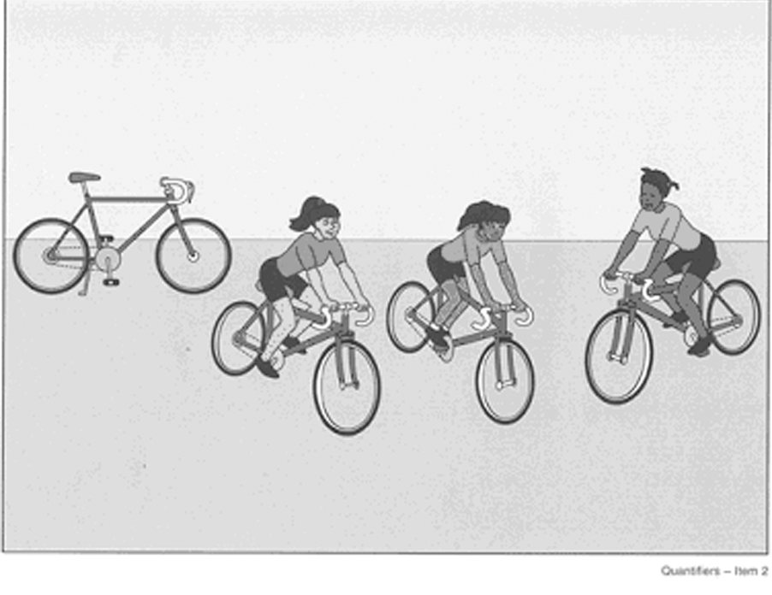
Quantifier Spreading 1. Classic spreading
Is every girl riding a bicycle?
No, not that one.

Slide 8
Explanation 1:
QS is quantification over (sub)events (Philip 1995)
Is every girl riding a bicycle? = ‘Is every subevent an event of a girl riding a bicycle?’
Counter-evidence: QS in non-eventive sentences:
Is every girl a bicycle rider?
No, not that one.

Slide 9
Explanation 2: QS is a parsing problem repaired by pragmatics
(Drozd 2001, Geurts 2003):
Children treat universals as if they were
weak quantifiers with no fixed domain.
They supply the domain of quantification pragmatically.
Replacing (b) with (c):
Every girl is riding a bicycle.
[ x: girl(x)] <every> [y: bicycle(y), x rides y]
c.[ ... : ... ] <every> [x, y: girl(x), bicycle(y), x rides y]

Slide 10
Explanation 3: Relevance Account (Philip 2011):
Universal quantification triggers exhaustive enumeration verification, which activates symmetrical pattern recognition.
The missing object spoiling symmetry is salient for the child, who imagines it to be existent.

Slide 11
An observation not explained by any theory: The frequency of QS can be changed by manipulating the pragmatic conditions:
Richer visual or linguistic context
(e.g., more than one extra object)
or a backgrounded extra object may reduce QS.
Both increasing the number of extra objects,
and decreasing the size of extra objects?

Slide 12
Hypothesis:
Children give non-adult-like answers because they consider all the elements in the visual stimulus relevant.
They assume that all the icons represented in the pictures are to be accounted for; their totality constitutes the domain of quantification.

Slide 13
Why? Because they interpret the stimuli as ostensive signals.
When the visual stimulus in a sentence-picture matching task is a minimal model abstracting away from the details of the situation, children regard the elements of the stimulus as ostensive clues representing all and only the relevant elements to be matched with the sentence.

Slide 14
Experimental evidence
Objectives: To show that
if the visual stimuli containing only a few icon-like elements are replaced by photos rich in accidental details, they are not misunderstood as ostensive signals, and QS is radically reduced.

Slide 15
Experimental procedure
Subjects: 82 children from 5 kindergartens
Mean age: 5;3 years
Adult control: 24 university students,
Mean age: 21 years (SD=1,61)
Method:
Sentence-picture matching; truth value judgement

Slide 16
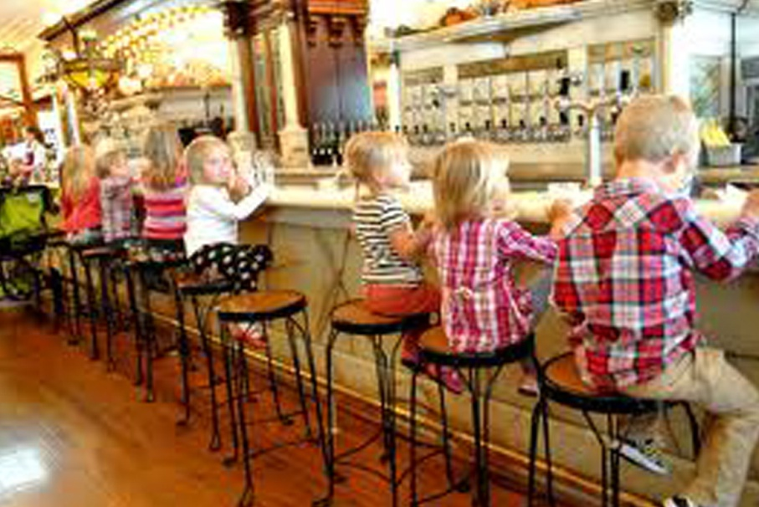
Experimental procedure
Stimuli: 8 test sentences, each coupled with a corresponding iconic drawing and a photo
Every child is sitting on a high chair.

Slide 17
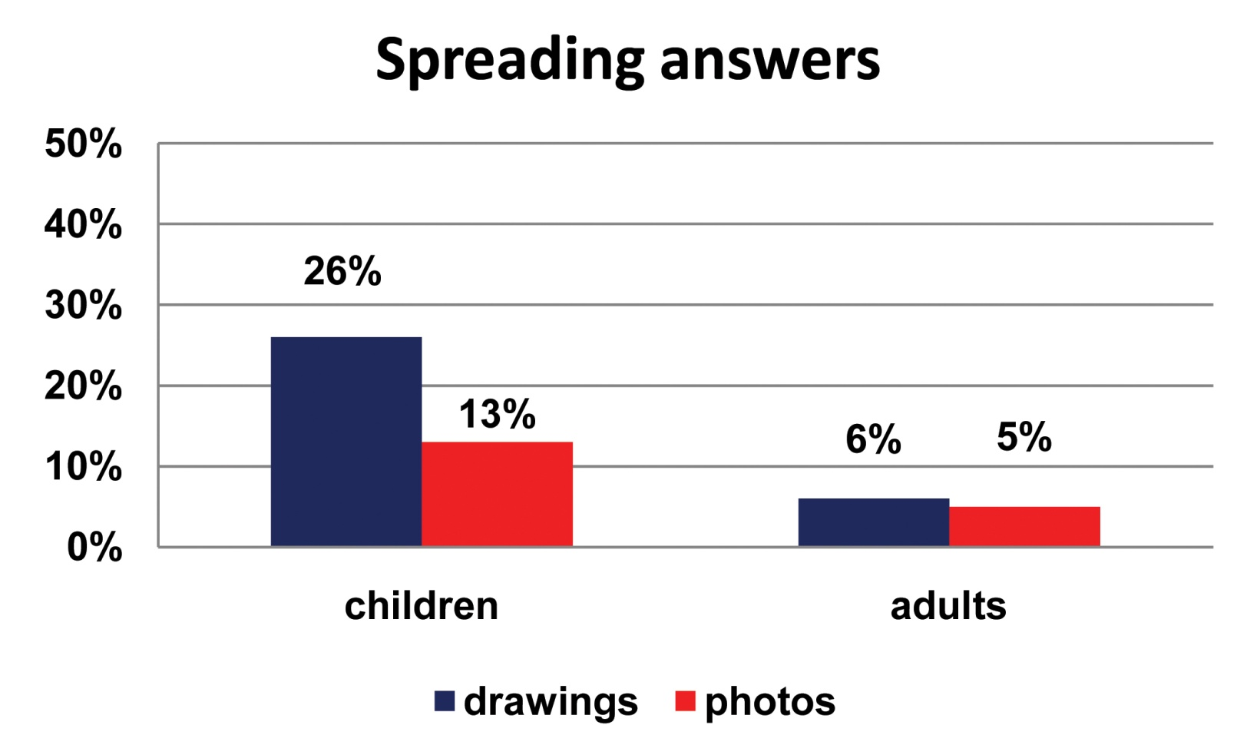
Results:
p>0,001

Slide 18
Discussion:
Experimenters use iconic stimuli to eliminate irrelevant distractors, to ensure that children are influenced by the relevant, controlled factor(s).
This method is mistaken when we want to test whether or not an element in the stimulus is relevant for the linguistic representation.
If the visual stimulus is a minimal model devoid of irrelevant details, children tend to interpret all of its elements as ostensive clues to be represented linguistically.

Slide 19
Discussion:
If the ostensive effect is diminished by the use of photos taken in natural environments, the proportion of QS is reduced by more than 50%.
Why does a richer linguistic or visual context or a backgrounded extra object reduce QS?
Both increasing the number of extra objects, and decreasing the size of extra objects reduces the illusion that they are ostensive signals to be represented linguistically.

Slide 20
Conclusion:
Quantifier Spreading, studied intensively for the past 50 years, is the artefact of misleading experimental methodology.

Slide 21
Case study 2: Scalar implicatures
Mary has 4 cards.
entails
Mary has 3 cards; Mary has 2 cards; M has 1 card
Hence
Mary has 3 cards = Mary has at least 3 cards

Slide 22
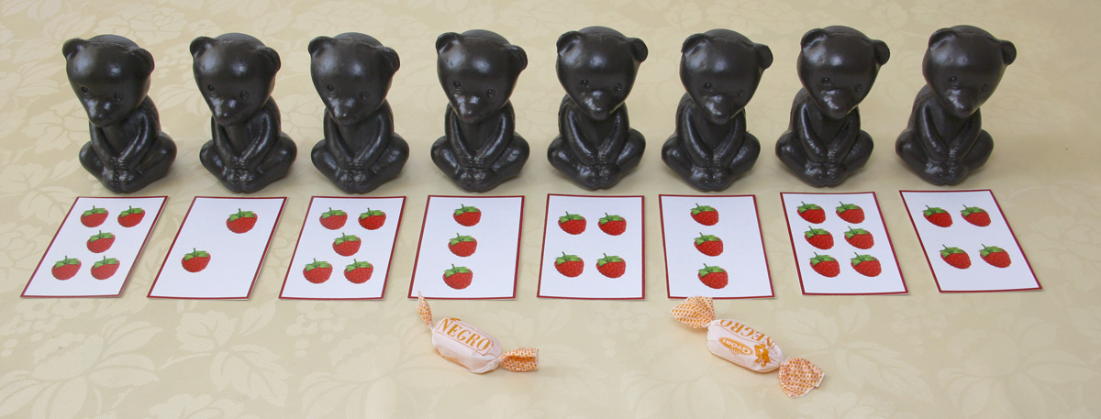
Experiment 1:
Experimenter: Hard-working bears get a reward. Give a candy to the bears that have picked three raspberries.

Slide 23
In a pure test situation proportion of non-adult-like answers: 100%
Participants: 20 preschoolers (mean age: 5;6)
Results:

Slide 24
Experiment 2: Game context; personal involvement of children
The experimenter and the child play a card game; the child ends up with 4 identical cards.
Experimenter:
If you have 3 identical cards, you get a balloon.
Child:
Sorry, I don’t have three.

Slide 25
In a game-like test situation proportion of non-adult-like answers: 72%
Participants: 18 preschoolers (mean age: 5;6)
Results:

Slide 26
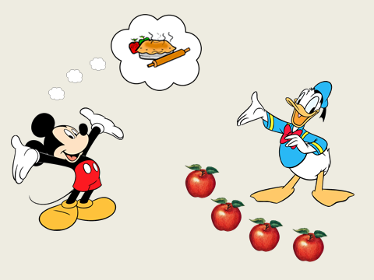
Experiment 3: emphasis not on numbers but on helping
Experimenter:
Mickey wants to bake an apple pie, but he needs three more apples.
Does Donald have three apples?

Slide 27
In this more natural test situation proportion of non-adult-like answers: 35%
Participants: 36 preschoolers (mean age: 5;4)
Results:

Slide 28
Experiment 4: acting out in natural situations
Joint activity unrelated to the test task.
On the table: 4-5 glasses, cups, sugar lumps in bowl
Experimenter:
We are thirsty. Can you find 3 glasses on the
table? If you can, please, pour us some water.

Slide 29
Exp. 4 testing number interpretation: acting out in natural situations
Experimenter:
The adults deserve some coffee. Are there 2 cups?
Yes, there are.
Then pour us some coffee!
Experimenter:
I drink coffee with 3 lumps of sugar. Are there 3 lumps in the sugar bowl?

Slide 30
In natural acting-out situations proportion of non-adult-like answers: 15%
Participants: 46 preschoolers
Mean age: 5;5 years
Results:

Slide 31
Discussion:
In test situations, children interpret numerals as ostensive signals.
The ostensive interpretation of numerals blocks their 'at least' reading.
The more we hide the test nature of the task, the weaker the blocking effect,
the more adult-like the results.

Slide 32
Conclusion:
The test situation itself may lead to the ostensive (in this case: literal) interpretation of the stimulus.
Acting-out tasks in natural situations are exempt from the ostension effect.

Slide 33
Ways of eliminating the ostension effect
In experiments testing the linguistic relevance of an item, this item must not be the only potentially irrelevant element of the stimulus.
2. Tests should be embedded in natural situations.

Slide 34
References
Butler, L.P, Markman, E.M. 2012. Preschoolers use intentional and pedagogical cues to guide inductive inferences and exploration. Child Development 83.
Csibra, G., Gy. Gergely (2009) Natural Pedagogy. Trends in Cognitive Sciences 13.
Drozd, K.F. (2001) Children’s weak interpretations of universally quantified sentences. In Conceptual Development and Language Acquisition, ed. M. Bowerman and S.C. Levinson, 340-376. CUP.
Gerőcs, M. & Pintér, L. (2014) How do Hungarian preschoolers interpret number words? In: Kohlberger, M., Bellamy, K. & Dutton, E. (eds.): ConSOLE XXI. Leiden, Leiden University Centre for Linguistics, 104–122.
Geurts, B. (2003) Quantifying kids. Language Acquisition 11: 197-218.
Philip, W. 1995. Event quantification in the acquisition of universal quantification. PhD diss., Umass, Amherst.
Philip, W. 2011. Acquiring knowledge of universal quantification. In Handbook of Generative Approaches to Language Acquisition, ed. J. de Villiers, T. Roeper, 351-394. Dordrecht: Springer.
Sperber, D., Wilson, D., 1986, 1995. Relevance: Communication and Cognition. Blackwell, Oxford.

