Slide 1
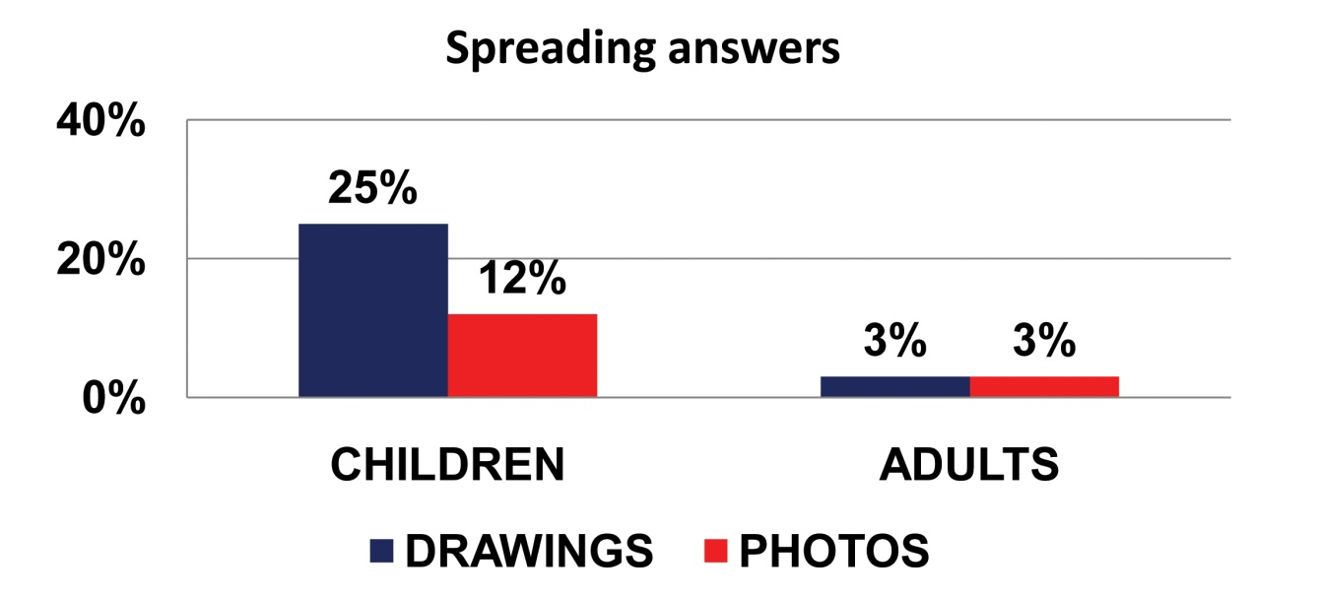
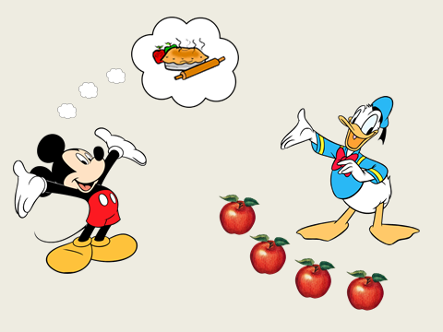
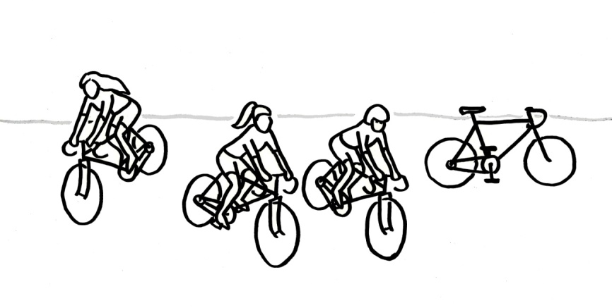
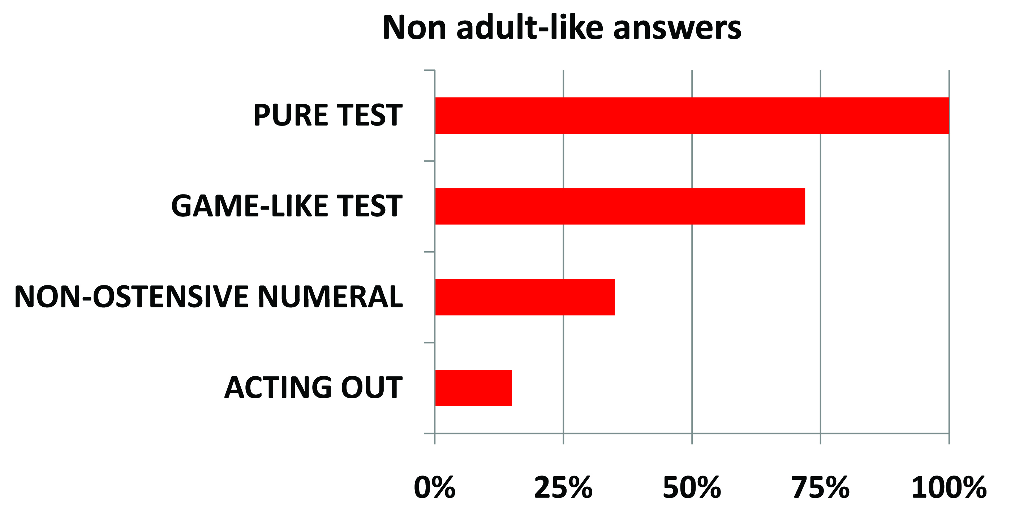
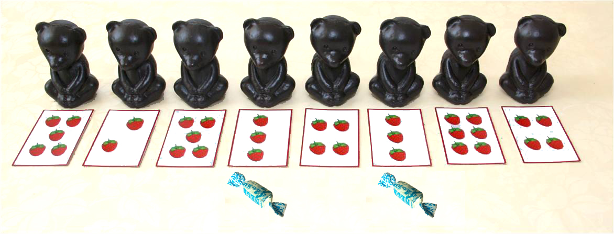
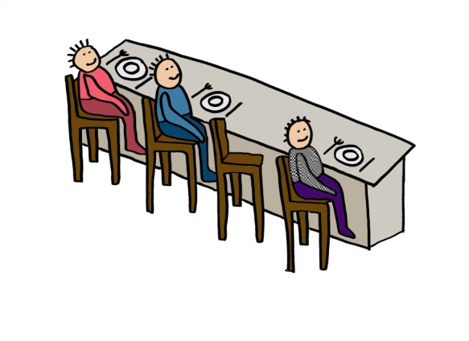
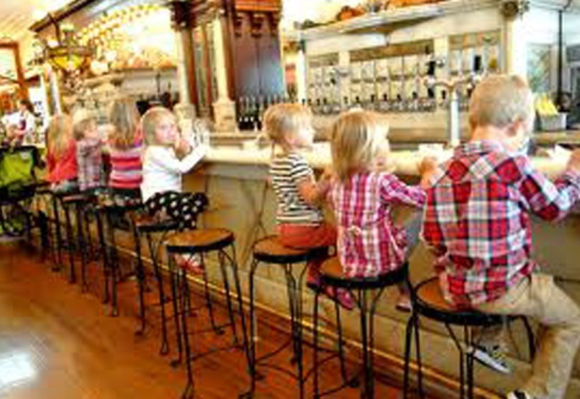
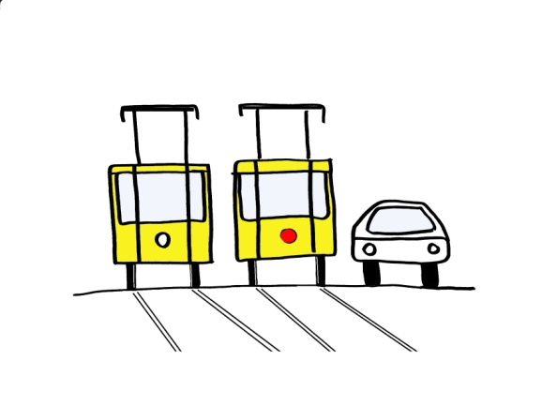
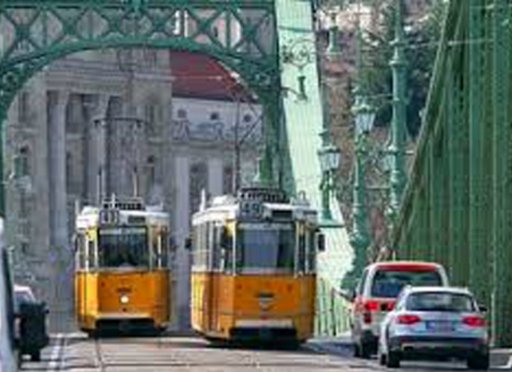
Ostention effect in experiments testing children’s interpretation of quantification
Katalin É. Kiss, Lilla Pintér, Tamás Zétényi Research Institute for Linguistics of the Hungarian Academy of Sciences
Claim: Preschoolers’ apparent difficulties with quantifier interpretation arise from methodological problems, and provide no evidence of immature linguistic competence.
GALA 12 University of Nantes
September 10-12, 2015.
The reason for the unexpected reaction:
(i) the iconicity of the visual stimulus, or
the test situation itself, which may induce the child to interpret the stimuli as ostensive communication.
Relevance Theory (Sperber&Wilson 1986), Natural Pedagogy (Csibra&Gergely 2009): Ostensive communication provides information (i) changing the listener’s cognitive state, and (ii) information communicating that the first layer of information is presented intentionally.
Children are predisposed to show preferential attention to ostensive communication. They encode the content of ostensive communication as highly relevant episodic information or as generalizable knowledge.
QUANTIFIER SPREADING
"Is every girl riding a bicycle?”
"No, not that one.”
Former explanations:
1: QS is quantification over (sub)events (Philip 1995).
2: QS is a parsing problem repaired by pragmatics (Drozd 2001, Geurts 2003)
3: Relevance Account (Philip 2011): Universal quantification triggers exhaustive enumeration verification, which activates symmetrical pattern recognition. The missing object spoiling symmetry is salient for the child, who imagines it to be existent.
Hypothesis:
As the visual stimulus lacks episodic details, children interpret every element of it as an ostensive signal relevant for the linguistic representation. They find the sentence inadequate because it does not represent every visual element judged as relevant.
A richer visual or linguistic context reducing the ostensivity of the individual visual elements reduces QS.
Experimental evidence:
Objective: To show that if the visual stimuli containing only a few icon-like elements are replaced by photos rich in accidental details, QS is radically reduced.
Experimental procedure:
Subjects: 82 children, Mean age: 5;3 years. Adult control: 24 university students
Method: Sentence-picture matching; truth value judgement
Stimuli: 8 sentences, each coupled with a corresponding iconic drawing and a photo.
e.g.:
Results:
Discussion:
If the visual stimulus is a minimal model devoid of irrelevant details, children tend to interpret all of its elements as ostensive clues to be represented linguistically. If the ostensive effect is diminished by the use of photos taken in natural environments, the proportion of QS is reduced by more than 50%.
The use of iconic stimuli is mistaken when we want to test whether or not an element in the stimulus is relevant for the linguistic representation.
Conclusion:
Quantifier Spreading, studied intensively for the past 50 years, is the artefact of misleading experimental methodology.
SCALAR IMPLICATURES
The implicature:
Mary has 4 cards → Mary has 3 cards; Mary has 2 cards; Mary has 1 card.
The interpretation tested:
Mary has three cards = ‘Mary has at least three cards.’
Experiment 1: Traditional test situation
Subjects: 20 preschoolers (mean age: 5;6)
Experimenter: "The bears have picked berries. Good workers get a reward.
Give a candy to the bears that have picked three raspberries.”
Results: All children gave a candy only to bears with exactly 3 berries.’.
In a pure test situation, the proportion of non-adult-like answers: 100%.
Experiment 2: Game context; personal involvement of children
Subjects: 18 preschoolers (mean age: 5;6)
Method: The experimenter and the child play a card game;
the child ends up with 4 identical cards.
Experimenter: "If you have three identical cards, you get a balloon.”
Most children: "Sorry, I don’t have three.”
Results: In a game-like test situation, the proportion of non-adult-like answers: 72%
Experiment 3: Emphasis not on numbers but on helping
Participants: 36 preschoolers (mean age: 5;4)
Experimenter: "Mickey wants to bake an apple pie, but he needs three more apples.
Does Donald have three apples?”
Results: 65% of children: " Yes”.
In a test situation with no ostensive numeral: the proportion of non-adult-like answers: 35%
Experiment 4: Acting out in natural situations
Participants: 46 preschoolers . Mean age: 5;5 years
Method: Joint activity unrelated to the test task. On the table: 4-5 glasses, cups, etc.
Experimenter: " We are thirsty. Can you find 3 glasses on the table for us to drink?”
Most children: " Yes, I can.”
Experimenter: " The adults deserve some coffee. Are there 2 cups there?”
Most children: " Yes, there are.”
Results: In natural acting-out situations proportion of non-adult-like answers: 15%
Discussion:
In test situations, children interpret numerals as ostensive signals. The ostensive interpretation of numerals blocks their 'at least' reading. The more we hide the test nature of the task, the weaker the blocking effect, the more adult-like the results.
Conclusion:
The test situation itself may lead to the ostensive (literal) interpretation of the stimulus. Acting-out tasks in natural situations are exempt from the ostension effect.
Ways of eliminating the ostension effect:
In experiments testing the linguistic relevance of an item, this item must not be the only potentially irrelevant element of the stimulus.
Tests should be embedded in natural situations.
References:
Csibra, G., Gy. Gergely (2009) Natural Pedagogy. Trends in Cognitive Sciences, Vol.13 No.4, 148-153. Drozd, K.F. (2001) Children’s weak interpretations of universally quantified sentences. In Conceptual Development and Language Acquisition, ed. M. Bowerman and S.C. Levinson, 340-376. CUP. Gerőcs, M. & Pintér, L. (2014) How do Hungarian preschoolers interpret number words? In: Kohlberger, M. Bellamy, K. & Dutton, E. (eds.): ConSOLE XXI. Leiden, Leiden Univ. Centre for Linguistics, 104–122. Geurts, B. (2003) Quantifying kids. Language Acquisition 11: 197-218. Philip, W. 1995. Event quantification in the acquisition of universal quantification. PhD diss. Umass Amherst. Philip, W. 2011. Acquiring knowledge of universal quantification. In Handbook of Generative Approaches to Language Acquisition, ed. J. de Villiers, T. Roeper, 351-394. Dordrecht: Springer. Sperber, D., Wilson, D., 1986. Relevance: Communication and Cognition. Blackwell, Oxford.
.
"Every child is sitting on a high chair."
"Every street car is yellow."
This research was supported by grant 108951 of OTKA, the National Science Research Foundation of Hungary Contact: ekiss at nytud.hu Home page: www.nytud.hu/oszt/elmnyelv/kvantorok/index.html

