Slide 1
When is children’s scope interpretation non-isomorphic, and why?
Katalin É. Kiss & Tamás Zétényi
(ekiss@nytud.hu)
Research Institute for Linguistics of the Hungarian Academy of Sciences

Slide 2
Research question:
English children’s scope interpretation appears to be more isomorphic than Hungarian children’s scope interpretation, whereas
English adult language is less isomorphic than Hungarian adult language.
Why?

Slide 3
What is isomorphism? Preference for direct scope.
(1) Every horse didn’t jump over the fence.
’Every horse is such that it didn’t jump over the fence.’ every > not
’It is not the case that every horse jumped over the fence.’ not > every
(2) Donald didn’t find two guys.
a. ’It is not the case that Donald found 2 guys.’ not>2
b. ’There are 2 guys are that Donald didn’t find.’ 2>not

Slide 4
Musolino (1998): children’s scope interpretation is isomorphic.
Isomorphism with linear order or c-command?
Lidz & Musolino (2002): In left-branching Kannada, wide scope assigned to rightmost operator
Q2
→ isomorphism with structural hierarchy
Q1

Slide 5
Road map
Alternative explanations of Observed Isomorphism.
Scope in Hungarian adult language is isomorphic.
Experimental evidence that scope in Hungarian child language is not isomorphic.
Observed Isomorphism does not extend to doubly quantified sentences across languages.
Hypothesis: their default reading is the collective one.
Distributive readings involve garden-paths, where interpretation is dissociated from the flow of speech.
6. Experimental evidence of garden-paths.

Slide 6
Explanations of observed isomorphism: 1. Immature grammar
Musolino (1998): children cannot yet generate the complex structures that correspond to non-isomorphic interpretations.
Semantic Subset Principle (Crain & Thornton 1998) children initially make the assumption that allows the narrower range of options →
all quantifiers are interpreted in situ

Slide 7
Explanations of observed isomorphism: 2. A consequence of parsing difficulties
Musolino & Lidz (2003, 2006), Gualmini (2004): children can access non-isomorphic readings if they are supported by the context.
Musolino & Lidz:
scopal ambiguity = garden-path situation, inverse scope requires the revision of the initial interpretation

Slide 8
The default strategy of interpretation: the assumption of isomorphism.
Why? Because
- surface scope is statistically most common
(cf. Gennari & MacDonald 2005/2006);
- its interpretation is least costly cognitively and computationally.

Slide 9
Explanations of observed isomorphism: 3. A pragmatic epiphenomenon
Gualmini (2004; 2008):
Question-Answer Requirement:
a sentence must be a ’good answer’ to the
Question under Discussion, entailing either Yes or No
Principle of Charity: children prefer the interpretation that corresponds to a Yes

Slide 10
Scope interpretation in Hungarian doubly quantified sentences
Scope interpretation in adult language: isomorphic
Overt Q-raising (adjunction to TP, NegP, FocP)
TopP
XP NegP
XP FocP
XP NegP
XP TP

Slide 11
Adjunction to TP:
(6)a. [_{TopP} Mari [_{TP}minden könyvet [_{TP}el olvasott]]]
Mary every book-acc prt read
’Mary read every book/two books.’
b. [_{TopP} A könyvet [_{TP}minden lány [_{TP}el olvasta]]]
the book-acc every girl prt read ’The book, every girl/two girls read.’

Slide 12
(7) Adjunction to FocP:
[_{FocP}Minden könyvet [_{FocP} KEVESEN olvastak[_{TP}el t_{V}]]
every book-acc few-pro read prt
‘Every book was read by few persons.‘ Every>FEW
(8) Adjunction to TP:
[_{FocP}KEVESEN olvastak [_{TP} minden könyvet [_{TP} el t_{V}]]
few-pro read every book-acc prt
‘Few persons read every book.' FEW>every

Slide 13
(9) Adjunction to NegP:
[_{NegP}Senki [_{NegP}nem [_{FocP}két könyvet olvasott[_{TP} el ]]]]
everybody not two book-acc read prt
’For everybody, it was not two books that he read.’
(10) Adjunction to FocP:
[_{NegP}Nem[_{FocP}mindenki[_{FocP}két könyvet olvasott[_{TP}el]]]]
not everybody two book-acc read prt
’Not everybody read two books.’

Slide 14
Q-raising can be iterated:
(11)
[_{TP} Legtöbb lány[_{TP} több könyvet is [_{TP}el olvasott]]]
most girl several book-acc dist prt read
’Most girls were such that they read several books.’
(12)
[_{TP} Több könyvet is[_{TP}legtöbb lány [_{TP} el olvasott]]]
several book-acc dist most girl prt read
’Several books were such that most girls read them.’

Slide 15
Prediction:
If Hungarian adult imput is isomorphic,
if child language is even more isomorphic than adult language (Musolino 1998)
-->
Hungarian child language is fully isomorphic.

Slide 16
Our experiments refute the isomorphism of Hungarian child language!
Experiment 1
Research question:
Can children access distributive scope?
Method: sentence-picture matching,
truth value judgements
Subjects: 46 preschoolers, mean age 6;5
Procedure: 15 sentence - picture pairs
11 fillers, 4 test cases

Slide 17
Four conditions:
C 1: SOV with direct scope
C 2: SOV with inverse scope
C 3: OSV with direct scope
C 4: OSV with inverse scope

Slide 18
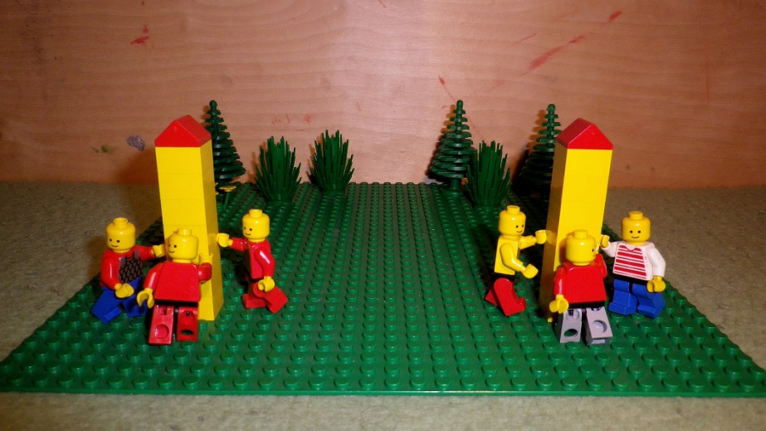
OSV with direct scope:
(13) Két tornyot is három fiú épít.
two tower-ACC dist three boy-NOM builds
’Two towers (each), three boys are building.‘

Slide 19
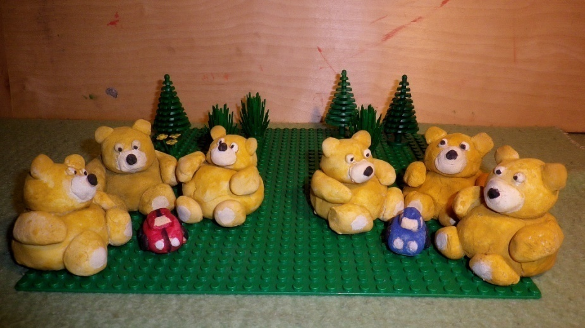
SOV with inverse scope:
(14) Három maci is két autóval játszik.
three bear dist two car-with plays
’Three teddy bears each are playing with two cars.’

Slide 20
Results:
C 1: SOV with direct scope: 91%
C 2: SOV with inverse scope: 63%
C 3: OSV with direct scope: 67%
C 4: OSV with inverse scope: 41%

Slide 21
Adult control group
C 1: SOV with direct scope: 80%
C 2: SOV with inverse scope: 11%
C 3: OSV with direct scope: 65%
C 4: OSV with inverse scope: 1%

Slide 22
Interim conclusion:
Children show
only slight bias towards isomorphism;
they are less isomorphic than adults.

Slide 23
Experiment 2
Research question:
Do children prefer direct or inverse scope?
Method: forced choice between pictures representing direct and inverse scope
Participants: 41 preschoolers, mean age 6;6
Procedure: 20 pairs of pictures associated with a doubly quantified sentence
12 fillers, 8 test cases

Slide 24
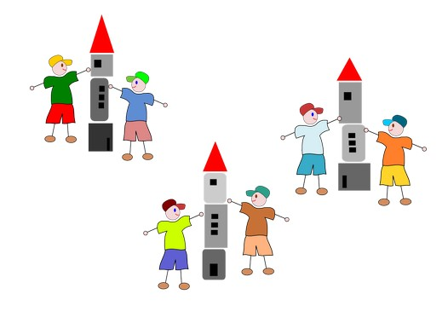
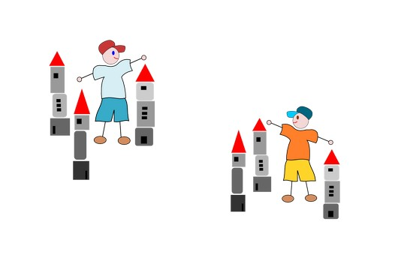
E.g.: (15) Két fiú is három tornyot épít. two boy each three tower builds ’Two boys each are building three towers.’

Slide 25
(16) Három tornyot is két fiú épít. three tower-ACC each two boy-NOM builds ‘Three towers each, two boys are building.’

Slide 26
children
adults

Slide 27
Interim conclusion
Children show
only mild bias towards isomorphism;
they are much less isomorphic than adults.

Slide 28
ii. Gennari and MacDonald (2005/2006)
Children are sensitive to the distributional patterns of language use
iii. Gualmini (2004; 2008): irrelevant:
a Question under Discussion can be constructed just as easily for both scope readings

Slide 29
A potential explanation: the kindergarten-path effect
Trueswell et al. (1999):
preschoolers are reluctant, or unable, to revise their original interpretation of an ambiguous sentence.

Slide 30
What is the default reading in the case of scopal ambiguity?
In sentences with quantification and negation:
the isomorphic reading.
In doubly quantified sentences:
the collective reading.

Slide 31
Experiment 3: Acting out
Research question: How do children interpret doubly quantified sentences in acting-out tasks?
Method: Participants provided with 6 toy bears, 6 toy boats, 6 cars, 6 candies, and 2 little benches.
Participants: 48 preschoolers (mean age 6;6).
Procedure:
Acting out 4 test sentences and 8 fillers

Slide 32
Test sentences
(19) Három maci is két hajóval játszik.
three teddy dist two boat-with plays
’Three bears each are playing with two boats.’
(20) Két autóval is három maci játszik.
two car-with dist three bear plays
’With two cars each, three bears are playing.’
(21) Három maci is két cukorkát kapott.
three bear dist two candy-acc received
’Three teddy bears each received two candies.’
(22) Két padon is három maci ül.
two bench-on dist three bear sits
’On two benches each, three bears are sitting.’

Slide 33
Results:
(C1) Three bears each are playing with two cars.
S O [V_{coll/dist}]: Distributive: 0% Collective: 100%
(C2) With two cars each, three bears are playing.
O S [V_{coll/dist}]: Distributive: 0% Collective: 100%
(C3) Three bears each received two candies.
S O [V_{dist (coll)}]: Distributive: 25% Collective: 75%
(C4) On two benches each, three bears are sitting.
Loc S [V_{dist}]: Distributive: 65% Collective: 35%

Slide 34
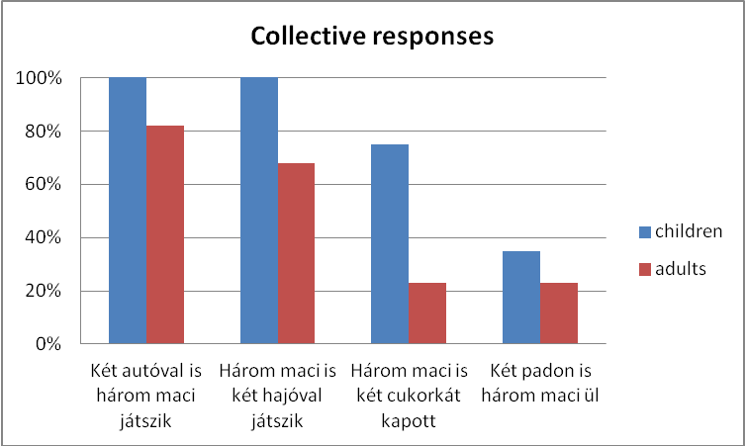
The ratio of Collective responses

Slide 35
Conclusion:
Default reading of doubly quantified sentences: collective
Distributive readings of doubly quantified sentences → garden-path
Distributive readings dissociated from the flow of speech →
scope order of the two quantifiers dissociated from linear order.

Slide 36
Evidence for garden-path (cf. Anderson 2004):
The computation of distributive readings requires significantly more time than the computation of collective readings.

Slide 37
Experiment 4:
Research question: reaction times of
(i) collective,
(ii) direct distributive and
(iii) inverse distributive readings
Method: measuring reaction times of truth value j’s
Participants: 24 preschoolers (mean age 5;11)
Procedure: 4 doubly quantified sentences presented with 3 pictures showing their collective, direct distributive, and inverse distributive readings.
12 test cases, 12 fillers

Slide 38
Conditions:
C1: SOV 2>3
C2: SOV 3>2
C3: OSV 2>3
C4: OSV 3>2
E.g.
(23) Két lány is három virágot locsol.
two girl each three flower-acc waters
‘Two girls each are watering three flowers.’
Picture A: 2 girls, 3 flowers
Picture B: 2 girls, 6 flowers
Picture C: 6 girls, 3 flowers

Slide 39
Results:
Average reaction time of TVJs of
collective readings: 1065 ms
Average reaction time of TVJs of
direct distributive readings: 1629 ms
Average reaction time of TVJs of
inverse distributive readings: 2149 ms

Slide 40
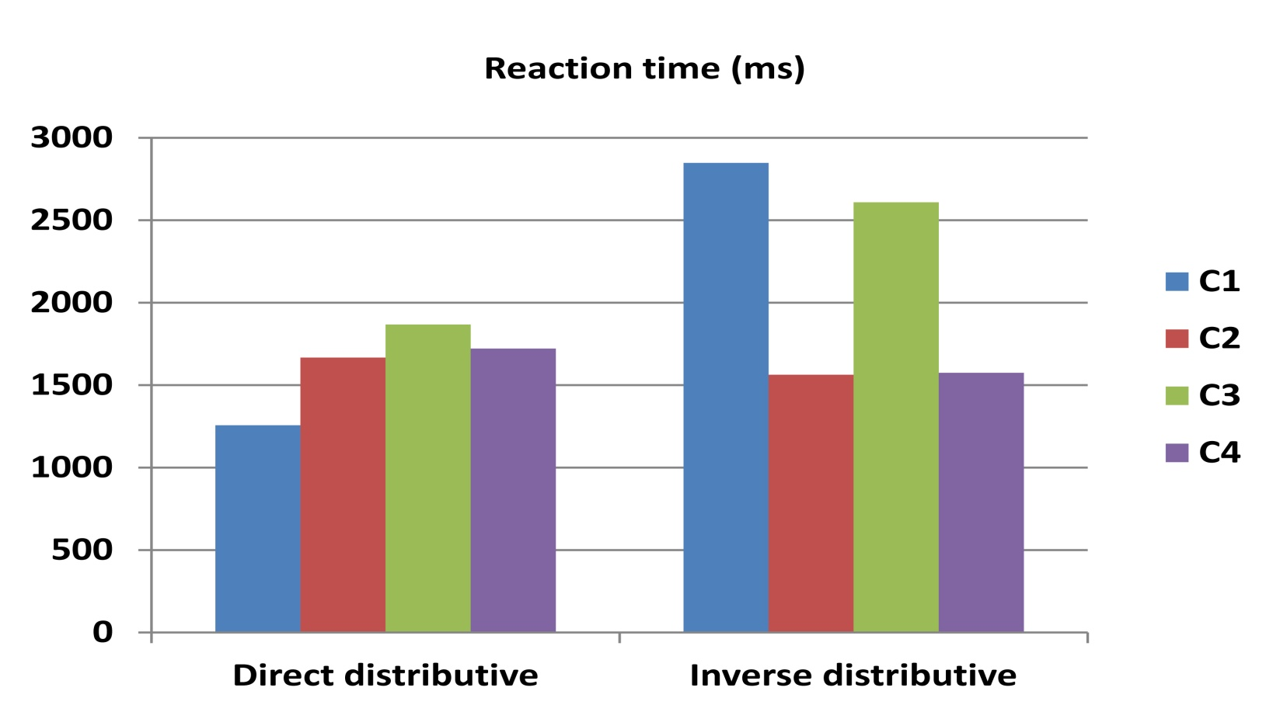
High variability of distributive interpretations

Slide 41
Conclusion
Children interpreting scopally ambiguous sentences face a garden-path problem.
In case of negation+quantification, the default reading is the isomorphic reading.
In case of doubly quantified sentences, the default reading is the collective reading.
The distributive readings are accessed with variable strategies.

Slide 42
References
Anderson, C., 2004. The structure and real-time comprehension of quantifier scope ambiguity. Doctoral Dissertation, Northwestern University.
Aoun, J., Li, A. Y-H., 1993. Syntax of Scope. MIT Press, Cambridge, MA.
Crain, S., Thornton, R., 1998. Investigations into Universal Grammar: A Guide to Experiments on the Acquisition of Syntax and Semantics. MIT Press, Cambridge, MA.
É. Kiss, K., 1991. Logical structure in syntactic structure: the case of Hungarian. In: Huang, J., May, R. (Eds.), Logical Structure and Syntactic Structure. Reidel, Dordrecht, pp. 111–148.
É. Kiss, K., 2002. The Syntax of Hungarian. Cambridge University Press, Cambridge.
Gennari, S., MacDonald, M. 2005/2006. Acquisition of Negation and Quantification: Insights from Adult Production and Comprehension. Language Acquistion 13(2), 125-168.
Gualmini, A., 2008. The rise and fall of Isomorphism. Lingua 118, 1158-1176.
Lidz, J., Musolino, J., 2002. Children's command of quantification. Cognition 84(2), 113-154.
Lidz, J., Musolino, J., 2005/2006. On the Quantificational Status of Indefinites: The View
Musolino, J., 1998. Universal Grammar and the Acquisition of Semantic Knowledge: An Experimental Investigation of Quantifier-negation Interactions in English. Doctoral Dissertation, University of Maryland.
Musolino, J., 2011. Studying language acquisition through the prism of isomorphism. In: de Villiers, J., Roeper, T. (Eds.), Handbook of Generative Approaches to Language Acquisition. Springer Science & Business Media, New York.
Trueswell, J. C., Sekerina, I. A., Hill, N., Logrip, M., 1999. The kindergarten path effect: Studying on-line sentence processing in young children. Cognition 73, 89-134.

