Slide 1
Hungarian preschoolers’ interpretation of doubly quantified sentences
Katalin É. Kiss, Mátyás Gerőcs, Tamás Zétényi
Research Institute for Linguistics of the Hungarian Academy

Slide 2
Research question: how do Hungarian preschoolers interpret quanti-fied sentences with two numerical quantifiers, e.g.
(1) Két fiú is három tornyot épít.
two boy DIST three tower-ACC builds
’Two boys (each) are building three towers’.

Slide 3
Previous experiments involving truth value judgment, forced choice, and acting-out tasks:
preschoolers have access to the distributive readings of doubly quantified sentences.
Follow-up question:
How do preschoolers determine relative scope?

Slide 4
What linguistic cues determin their scope choice? Do they associate sentence (1) with representation (a) or representation (b)?
Fig.a: Fig.b:
(1) Két fiú is három tornyot épít.
two boys each three towers-ACC build

Slide 5
Claim:
Children’s scope interpretation cannot be derived from linguistic factors alone,
it is affected by the structure of the visual representation of the event associated with the sentence.
In a forced choice task, they choose the representation that is easier to segment into identical subevents.

Slide 6
Background:
Musolino (1998): children assume isomorphism between the scope order & linear order of QPs.
Children have problems with inverse scope because
i. they cannot generate the complex structure associated with inverse scope (Musolino 2000)
ii. they cannot process such sentences (Musolino & Lidz 2003; Lidz et al. 2004)
iii. Gennari &MacDonald (2005/2006): children’s behavior reflects the distributional patterns of actual language use

Slide 7
Contradictory results from Chinese:
The scope interpretation of children is less isomorphic than the scope interpretation of adults
– cf. Thomas Hun-tak Lee (1997),
Zhou and Crain (2009)

Slide 8
Hungarian adult grammar: overt Quantifier-Raising, preverbal QPs c-command and precede their scope. Subject wide scope:
(2) FocP
2 fiú is_{j} FocP
3 tornyot_{k} Foc′
Foc TenseP
épít_{i}
Tense VP
t_{i}
NP V′
t_{j}
V NP
t_{i} t_{k}

Slide 9
Object wide scope:
(3) FocP
3 tornyot is_{k} FocP
2 fiú_{i} Foc′
Foc TenseP
épít_{i}
Tense VP
t_{i}
NP V′
t_{j}
V NP
t_{i} t_{k}

Slide 10
Scope interpretation by Hungarian preschoolers
É. Kiss–Gerőcs (2011):
Starting hypothesis: isomorphism:
wide scope assigned on the basis of linear precedence

Slide 11
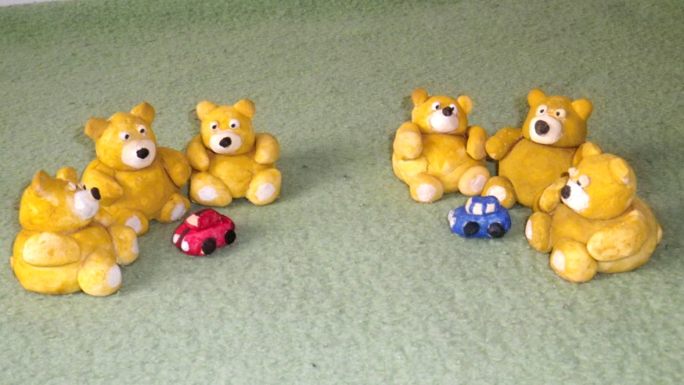
Hypotheses not borne out; scope preferences often cannot be derived from linguistic cues
E.g. Truth-value judgement of sentence - picture pairs:
(4) Három maci is két autóval játszik.
three teddy-bear DIST two car-with plays
‘Three teddy bears each are playing with two cars.’

Slide 12
Conditions and results (acceptance rates):
i. S > O (subj.-initial, direct scope): 91%
(3 bears, 6 cars)
ii. S < O (subj.-initial, inverse scope): 63%
6 bears, 2 cars)
iii. O > S (obj.-initial, direct scope): 67%
(2 cars, 6 bears)
O < S (obj.-initial, inverse scope): 41%
(6 cars, 3 bears)

Slide 13
A follow-up experiment checking the role of further linguistic factors
É. Kiss – Gerőcs – Zétényi (2012):
Hypothesis:
wide scope assigned to the
constituent that has a more prominent
grammatical function/theta role
Forced choice, acting-out tasks
Hypothesis again not fully borne out.

Slide 14
New hypotheses: children’s scope interpretation is affected by visual cues
Hypothesis 1: children assign wide scope to the quantified expression that has larger, more salient denotata in the visual representation.
Hypothesis 2: children choose the picture that is easier to divide into identical chunks representing identical subevents.

Slide 15
Experiment 1 Method
Subjects: 27 children, 12 boys + 15 girls,
mean age 6,5 years (SD=4 months)
Materials:
Subjects were shown 8 test sentences + 8 fillers, each accompanied by a pair of pictures.
They had to decide which of the two pictures the sentence is about.

Slide 16
Conditions
Condition i
SOV sentence, with the subject set more salient
Condition ii
SOV sentence, with the object set more salient
Condition iii
OSV sentence, with the object set more salient
Condition iv
OSV sentence, with the subject set more salient

Slide 17
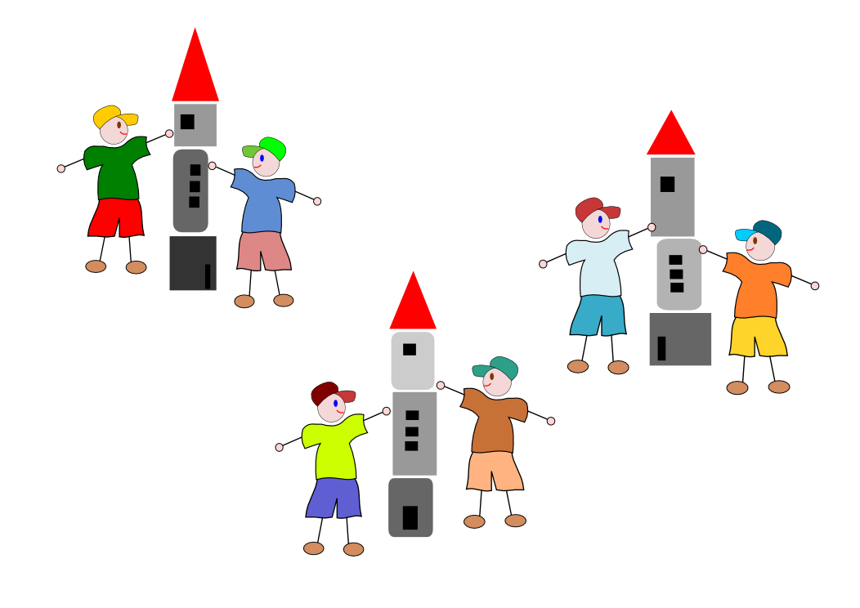
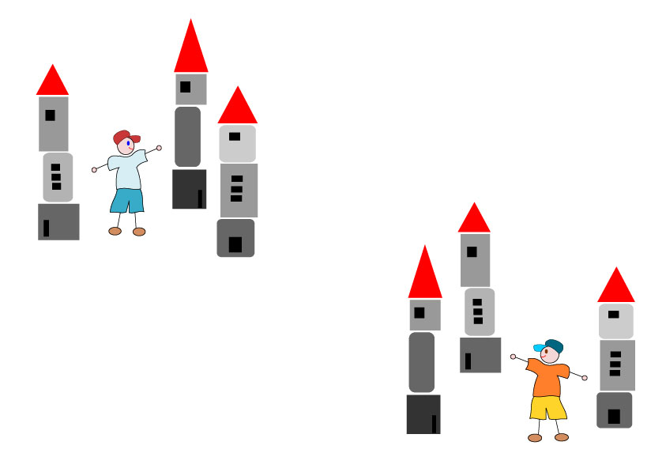
E.g., Condition iii: OSV sentence, with the object set more salient
Fig.a: Fig.b:
(5) Három tornyot is két fiú épít.
three tower-acc dist two boy builds
‘Three towers(each), two boys are building.’

Slide 18
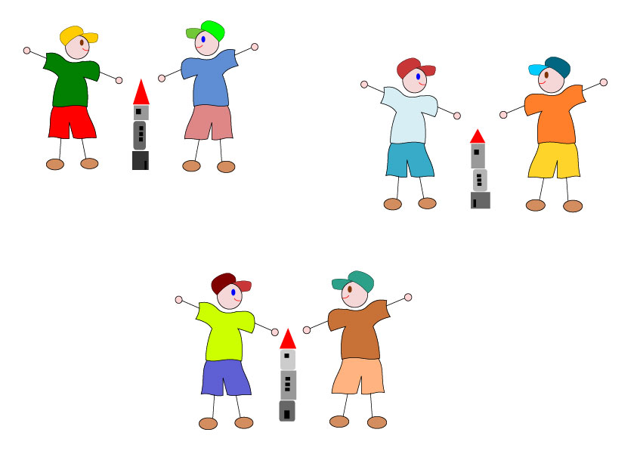
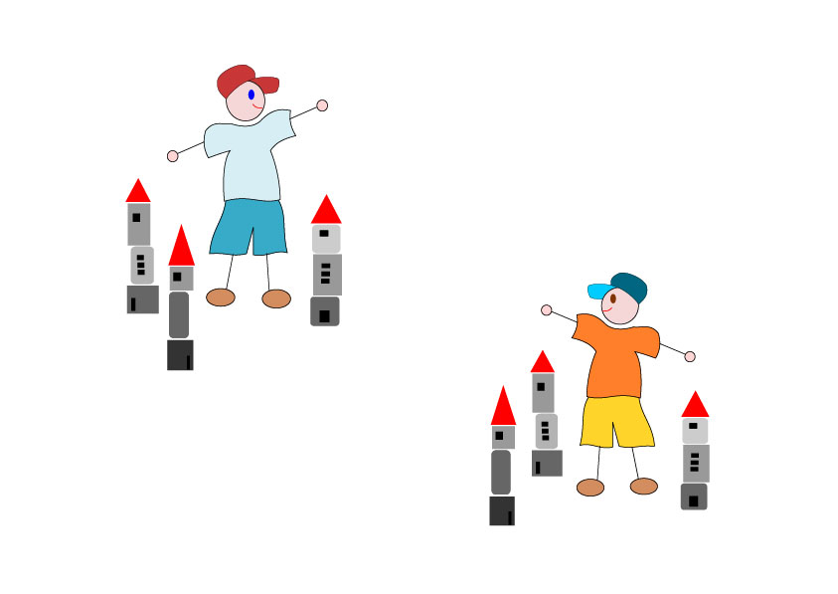
Condition iv: OSV sentence, with the subject set more salient
Fig.a: Fig.b:
(6) Három tornyot is két fiú épít.
three tower-acc dist two boy builds
‘Three towers (each) are being built by two boys.’

Slide 19
Results in conditions iii, iv
(7)b. Három tornyot is két fiú épít.
‘Three towers are being built by two boys.’
Condition iii. big towers, small boys:
direct scope (3 big towers, 6 small boys): 33%
inverse scope (6 big towers, 2 small boys): 67%
Condition iv. small towers, big boys:
direct scope (3 small towers, 6 big boys): 30%
inverse scope (6 small towers, 2 big boys): 70%
Hypothesis not borne out.

Slide 20
Experiment 2 Method
Subjects: 38 children, 18 boys + 20 girls,
mean age 6,5 (SD=4 months)
Materials:
Subjects were shown 8 test sentences + 7 fillers.
Test sentences were accompanied by pairs of
pictures, showing their direct & inverse scopes.
They had to decide which of the two pictures the sentence is about.

Slide 21
One member of each picture pair was chunked into identical subevents separated by spaces.
In the other picture, the members of the two sets were mixed.

Slide 22
Conditions:
Condition i
SOV, with the direct scope representation chunked
Condition ii
SOV, with the inverse scope representation chunked
Condition iii
OSV, with the direct scope representation chunked
Condition iv
OSV, with the inverse scope representation chunked

Slide 23
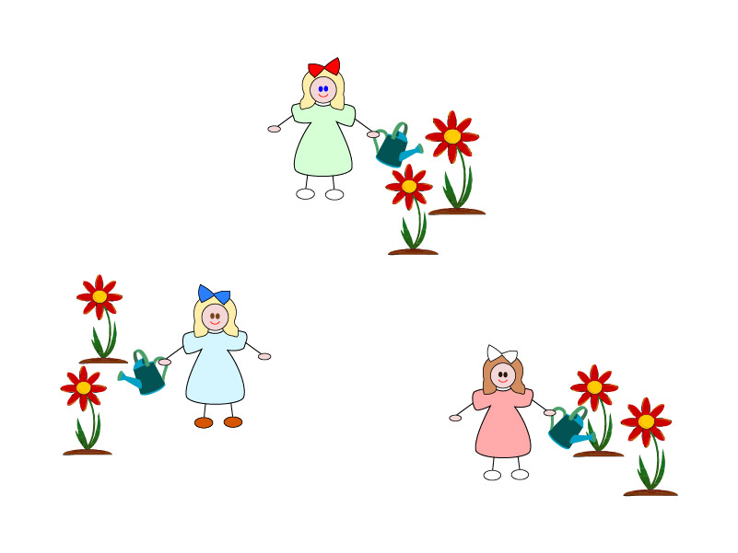
E.g., Condition i: SOV, with the direct scope representation chunked
Fig.a: Fig.b:
Fig. 14a
(7) Három lány is két virágot locsol.
three girl DIST two flower waters
’Three girls (each) are watering two flowers.’

Slide 24
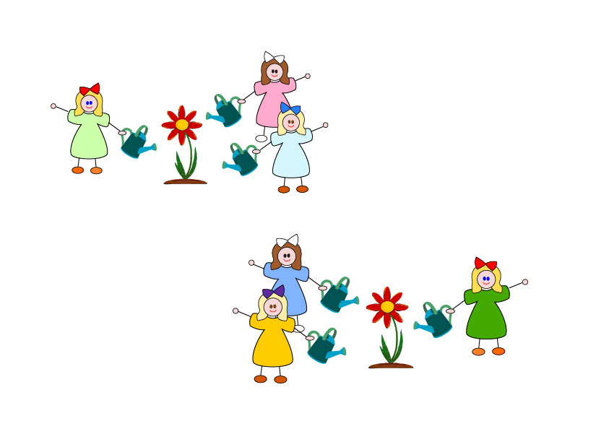
E.g., Condition ii: SOV, with the inverse scope representation chunked
Fig.a: Fig.b:
Fig. 18a. 18b
(7) Három lány is két virágot locsol.
three girl DIST two flower waters
’Three girls (each) are watering two flowers.’

Slide 25
Results: Preference for scope reading with a chunked visual representation:
Condition i: SOV, chunked direct scope: 66%
Condition ii: SOV, chunked inverse scope: 29%
Condition iii: OSV, chunked direct scope: 58%
Condition iv: OSV, chunked inverse scope: 71%

Slide 26
Hypothesis confirmed in conditions i, iii, iv. What about condition ii?
The visual stimuli may not have been sufficiently different.
(8) Két markoló is három gödröt ás.
two excavator DIST three hole-ACC digs
’Two excavators (each) are digging three holes.’

Slide 27
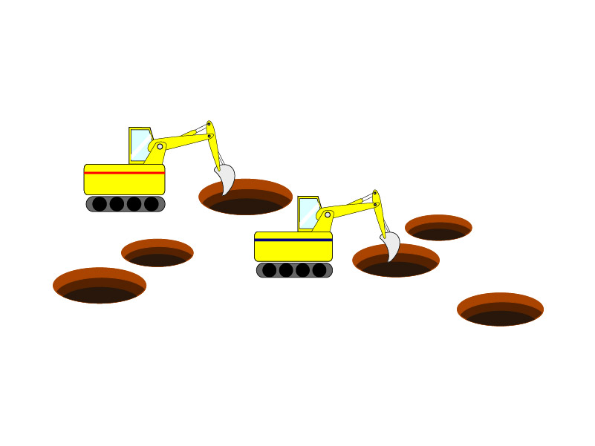
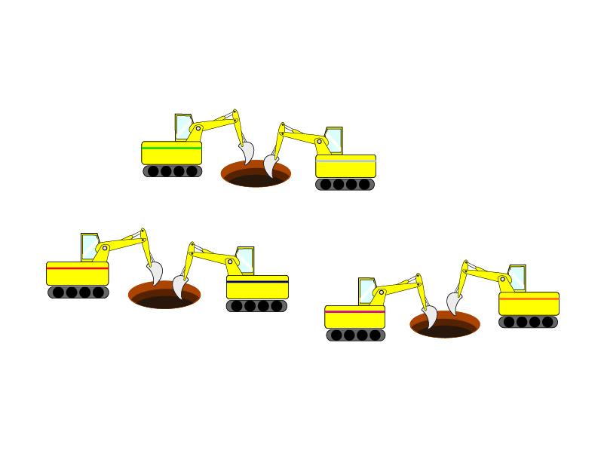
(8) Két markoló is három gödröt ás. two excavator DIST three hole-ACC digs
Fig. a: Fig. b:

Slide 28
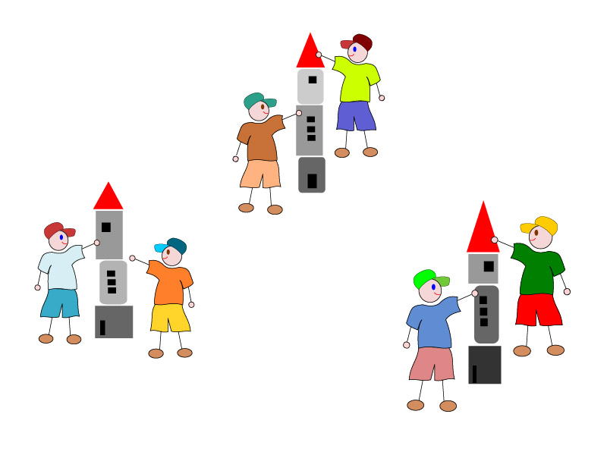
(9) Két fiú is három tornyot épít. two boy DIST three tower builds ’Two boys (each) are building three towers.’
Fig.a: Fig.b:
Fig. 15a Fig. 15b

Slide 29
(8), (9):
wide scope assigned to the initial, subject quantifier
When both pictures are easy to chunk into identical subevents, linguistic prominence factors decide scope preferences.

Slide 30
Conclusion:
The primary factor determining children’s preferred scope reading is the structure of the visual representation of the event.
Linguistic cues play a secondary role; the majority of subjects assign wide scope to the linguistically more prominent quantifier only if both visual representations are segmentable into identical subevents.

Slide 31
More generally:
Whereas adults processing a doubly quantified sentence have no problems in mentally reconstructing the complex situation presented linguistically,
preschoolers also exploit visual cues. →
Their processing abilities are still immature.

Slide 32
Eye tracking confirms that chunked visual information is easier to process:
Heat map:
Multiple eye-movements when observing mixed representations;
as many brief gazes as the number of subevents when observing chunked representations.
Much more time is spent on mixed representations than on chunked ones.

Slide 33
Chunking also helps infants to interpretat visual stimuli
Feigenson & Halberda (2004):
Infants can distinguish sets of individuals larger than 3 if the sets are chunked.

Slide 34
Chunking has also been claimed to play a role in the interpretation of universal quantifiers:
Philip (1995), Brooks & Braine (1996), Braine & Sekerina (1996), etc.:
Universal quantification in child grammar is quantification over (sub)events rather than individuals.

Slide 35
Quantification over (sub)-events is more elementary than quantification over individuals
Bach, Jelinek, Kratzer and Partee (1995):
A-quantification is primary to D-quantification.
A-quantification is universal, D-quantification is not – cf. Mohawk, Navajo, Lakhota, Straits Salish.
Languages with deficient number systems: the Amazonian Mundurucú, the Australian Warlpiri, Mayali, Gun-djeyhmi, only have A-quantification.

