Slide 1
„Ostention effect” in language acquisition experiments
Katalin É. Kiss, Mátyás Gerőcs, Lilla Pintér, Tamás Zétényi
Research Institute for Linguistics of the Hungarian Academy of Sciences
This research was supported by grant 108951 of OTKA, the National Science Research Foundation

Slide 2
Claim:
Presenting an utterance and its visual representation to a child in a test situation may elicit reactions that do not occur in natural, everyday circumstances.

Slide 3
The reason for the unexpected reaction:
the iconicity of the visual representation,
or the test situation itself,
which may induce the child to interpret the stimuli as ostensive communication.

Slide 4
Two case studies, and two ways of eliminating the ostension effect:
Quantifier spreading
The interpretation of numerals

Slide 5
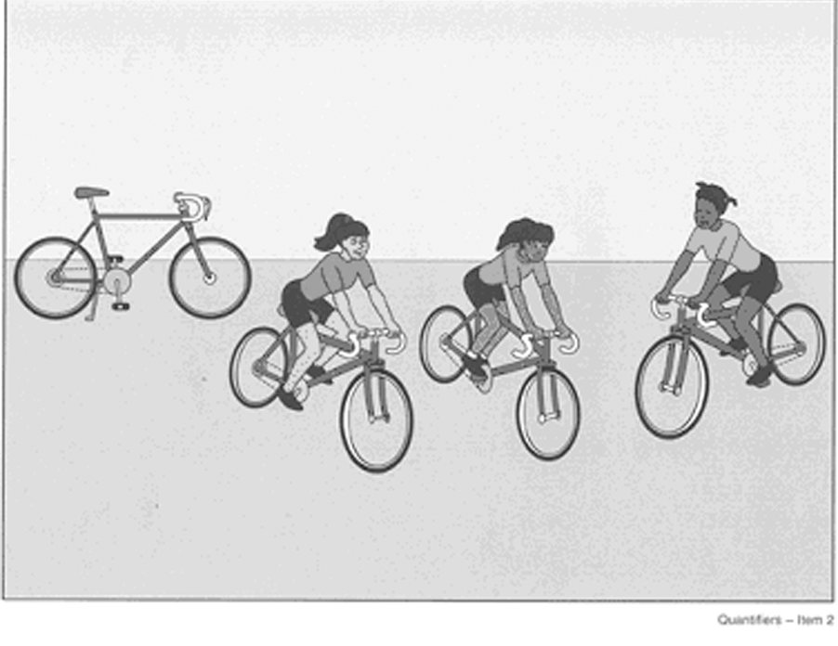
Quantifier Spreading 1. Classic spreading
Is every girl riding a bicycle?
No, not that one.

Slide 6
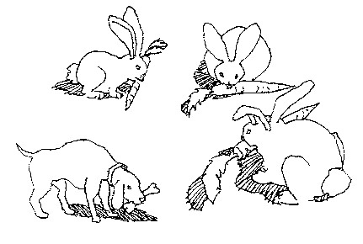
2. Bunny spreading
Is every bunny eating a carrot?
No, not that one.

Slide 7
Theories of Quantifier Spreading
Cognitive explanation:
Immature cognitive (logical) abilities
(Inhelder & Piaget 1958, 1964)

Slide 8
Linguistic explanation 1:
QS is quantification over (sub)events (Philip 1995)
Is every girl riding a bicycle? = ‘Is every subevent an event of a girl riding a bicycle?’
Counter-evidence: QS in non-eventive sentences:
Is every girl a bicycle rider?
No, not that one.

Slide 9
Linguistic explanation 2: QS is a parsing problem repaired by pragmatics
(Drozd 2001, Geurts 2003):
Children treat universals as if they were
weak quantifiers with no fixed domain.
They supply the domain of quantification pragmatically.
Replacing (b) with (c):
Every girl is riding a bicycle.
[ x: girl(x)] <every> [y: bicycle(y), x rides y]
c.[ ... : ... ] <every> [x, y: girl(x), bicycle(y), x rides y]

Slide 10
In fact, QS occurs with weak quantifiers
We found that 4 out of 32 children (12,5%)
show systematic QS with numerical quantifiers. E.g.
Picture showing 3 girls riding bicycles, and an extra bicycle:
Are three girls riding a bicycle?
No, four.

Slide 11
Linguistic explanation 3: Relevance Account (Philip 2011):
Universal quantification triggers exhaustive enumeration verification, which activates symmetrical pattern recognition.
The missing object spoiling symmetry is salient for the child, who imagines it to be existent.

Slide 12
A fact not explained by any theory: The frequency of QS can be changed by manipulating the pragmatic conditions:
Richer visual or linguistic context
(e.g., more than one extra object)
or a backgrounded extra object may reduce QS.
Both increasing the number of extra objects,
and decreasing the size of extra objects?

Slide 13
Hypothesis:
Children give non-adult-like answers because they consider all the elements in the visual stimulus relevant.
They assume that all the icons represented in the pictures are to be accounted for; their totality constitutes the domain of quantification.

Slide 14
Why? Because they interpret the stimuli as ostensive signals.
Children are predisposed to show preferential attention to ostensive communication.
They encode the content of ostensive communication as representing relevant episodic information or generalizable knowledge. (Csibra & Gergely 2009, etc.)

Slide 15
Claim:
When the visual stimulus in a sentence-picture matching task is a minimal model abstracting away from the details of the situation, children regard the elements of the stimulus as ostensive clues representing all and only the relevant elements to be matched with the sentence.

Slide 16
Experimental evidence
Objectives: To show that
if the visual stimuli containing only a few icon-like elements are replaced by photos rich in accidental details, they are not misunderstood as ostensive signals, and QS is radically reduced.

Slide 17
Experimental procedure
Subjects: 46 children from 3 kindergartens
Mean age: 5;5 years
Adult control: 24 university students,
Mean age: 21 years (SD=1,61)
Method:
Sentence-picture matching; truth value judgement

Slide 18
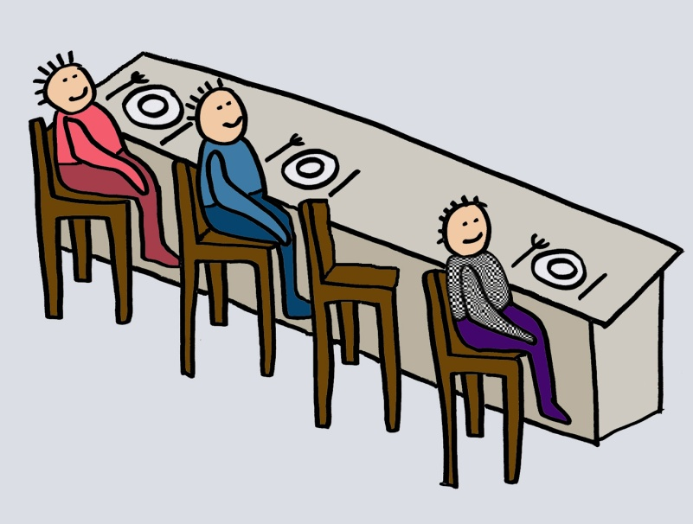
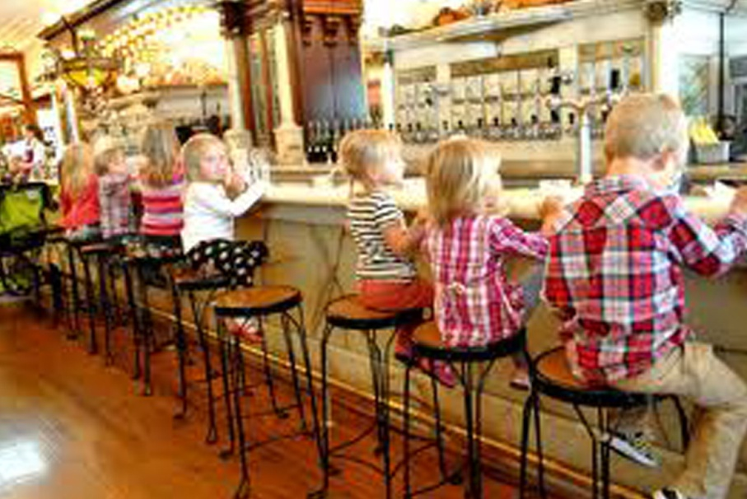
Experimental procedure
Stimuli: 8 test sentences, with a corresponding
iconic drawing and a corresponding photo
Every child is sitting on a high chair.

Slide 19
Results:
p>0,001
Notes:
photo: 22 answers out of 184 was spreading
drawings: 46 answers out of 184 was spreading
the difference is significant at p>0,001 (t_{paired}=3,49 df=183 p>0,001) by paired student t-test
adults: 5 and 6 out of 96 non significat - of course

Slide 20
Discussion:
Experimenters use iconic stimuli to eliminate irrelevant distractors, to ensure that children are influenced by the relevant, controlled factor(s).
This method is mistaken when we want to test whether or not an element in the stimulus is relevant for the linguistic representation.
If the visual stimulus is a minimal model devoid of irrelevant details, children tend to interpret all of its elements as ostensive clues to be represented linguistically.

Slide 21
Discussion:
If the ostensive effect is diminished by the use of photos taken in natural environments, the proportion of QS is reduced by more than 50%.
Why does a richer linguistic or visual context or a backgrounded extra object reduce QS?
Both increasing the number of extra objects, and decreasing the size of extra objects reduces the illusion that they are ostensive signals to be represented linguistically.

Slide 22
Conclusion:
Quantifier Spreading, studied intensively for the past 50 years, is the artefact of misleading experimental methodology.

Slide 23
Misleading ostension effect in other types of language acquisition experiments
Testing scalar implicatures:
Mary has 4 cards.
entails
Mary has 3 cards; Mary has 2 cards; M has 1 card
Hence
Mary has 3 cards = Mary has at least 3 cards

Slide 24
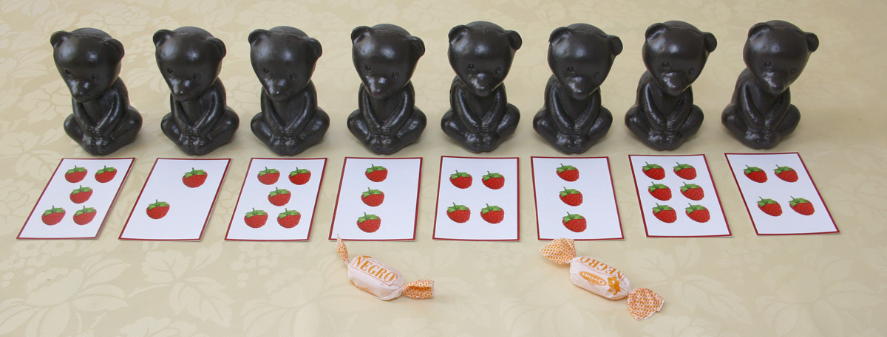
Exp. 1 testing the interpretation of number phrases
Experimenter: Hard-working bears get a reward. Give a candy to the bears that have picked three raspberries.

Slide 25
In this pure test situation proportion of wrong answers: 100%
Participants: 20 preschoolers (mean age: 5;6)
Results:

Slide 26
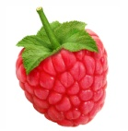
Exp. 2 testing number interpretation : Game context; personal involvement of children
The experimenter and the child play a card game; the child ends up with 4 identical cards.
Experimenter:
If you have 3 identical cards, you get a balloon.
Child:
Sorry, I don’t have three.

Slide 27
In a game-like test situation proportion of wrong answers: 72%
Participants: 18 preschoolers (mean age: 5;6)
Results:

Slide 28
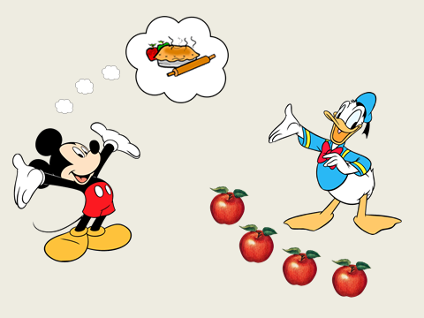
Exp. 3 testing number interpretation: emphasis not on numbers but on helping
Experimenter:
Mickey wants to bake an apple pie, but he needs three more apples.
Does Donald have three apples?

Slide 29
In this more natural test situation proportion of wrong answers: 35%
Participants: 36 preschoolers (mean age: 5;4)
Results:

Slide 30
Exp. 4 testing number interpretation: acting out in natural situations
Joint activity unrelated to the test task.
On the table: 4-5 glasses, cups, sugar lumps in bowl
Experimenter:
We are thirsty. Can you find 3 glasses on the
table? If you can, please, pour us some water.

Slide 31
Exp. 4 testing number interpretation: acting out in natural situations
Experimenter:
The adults deserve some coffee. Are there 2 cups so that you can pour us some coffee?
Experimenter:
I drink coffee with 3 lumps of sugar. Are there 3 lumps in the sugar bowl?

Slide 32
In natural acting-out situations proportion of wrong answers: 15%
Participants: 46 preschoolers
Mean age: 5;5 years
Results:

Slide 33
Discussion:
In test situations, children interpret numerals as ostensive signals.
The ostensive interpretation of numerals blocks their 'at least' reading.
The more we hide the test nature of the task, the weaker the blocking effect,
the more adult-like the results.

Slide 34
Conclusion:
The test situation itself may lead to the ostensive (in this case: literal) interpretation of the stimulus.
Acting-out tasks in natural situations are exempt from the ostension effect.

Slide 35
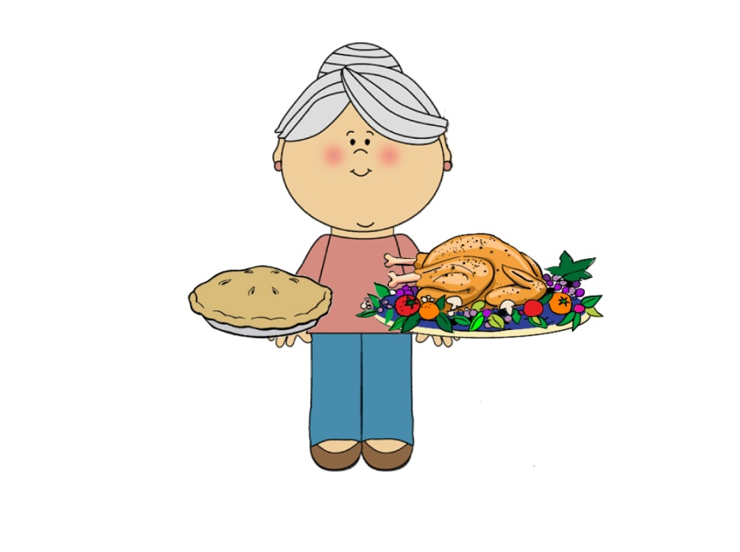
In test situations adults are also susceptible to the ostension effect
Research question:
Do children/adults understand the exhaustivity of Hungarian focus/English cleft constituent?
Truth value judgement of:
It was the pie that Grandma baked.
Nagyi a tortát sütötte meg.

Slide 36
Baseline: Grandma baked the cake. Nagyi megsütötte a tortát.
53% of adults and 32% of children also rejected the baseline sentence!

Slide 37
Conclusion:
In experiments testing children’s sentence interpretation, the stimuli are often misinterpreted as ostensive clues
→ they may elicit reactions that do not occur in natural circumstances.
The cause of misinterpretation:
the iconicity of the stimuli
the test situation itself.

Slide 38
Ways of eliminating the ostension effect
In experiments testing the linguistic relevance of an item, this item must not be the only potentially irrelevant element of the stimulus.
2. Tests should be embedded in natural situations.

Slide 39
References
Csibra, G., Gy. Gergely (2009) Natural Pedagogy. Trends in Cognitive Sciences 13, 148-153.
Drozd, K.F. (2001) Children’s weak interpretations of universally quantified sentences. In Conceptual Development and Language Acquisition, ed. M. Bowerman and S.C. Levinson, 340-376. CUP.
Gerőcs, M. & Pintér, L. (2014) How do Hungarian preschoolers interpret number words? In: Kohlberger, M., Bellamy, K. & Dutton, E. (eds.): ConSOLE XXI: Proceedings of the 21st Conference of the Student Organization of Linguistics in Europe (8-10 January 2013, Potsdam). Leiden, Leiden University Centre for Linguistics, 104–122.
Geurts, B. (2003) Quantifying kids. Language Acquisition 11: 197-218.
Inhelder, B. & Piaget, J. (1958) The Growth of Logical Thinking from Childhood to Adolescence. London: Routledge and Kegan Paul.
Inhelder, B., & Piaget,J. (1964) The Early Growth of Logic in the Child. New York: Harper
Philip, W. 1995. Event quantification in the acquisition of universal quantification. PhD diss., Umass, Amherst.
Philip, W. 2011. Acquiring knowledge of universal quantification. In Handbook of Generative Approaches to Language Acquisition, ed. J. de Villiers, T. Roeper, 351-394. Dordrecht: Springer.

