Slide 1
Quantifier spreading: children misled by ostensive cues
Katalin É. Kiss & Tamás Zétényi
Research Institute for Linguistics of the Hungarian Academy of Sciences

Slide 2
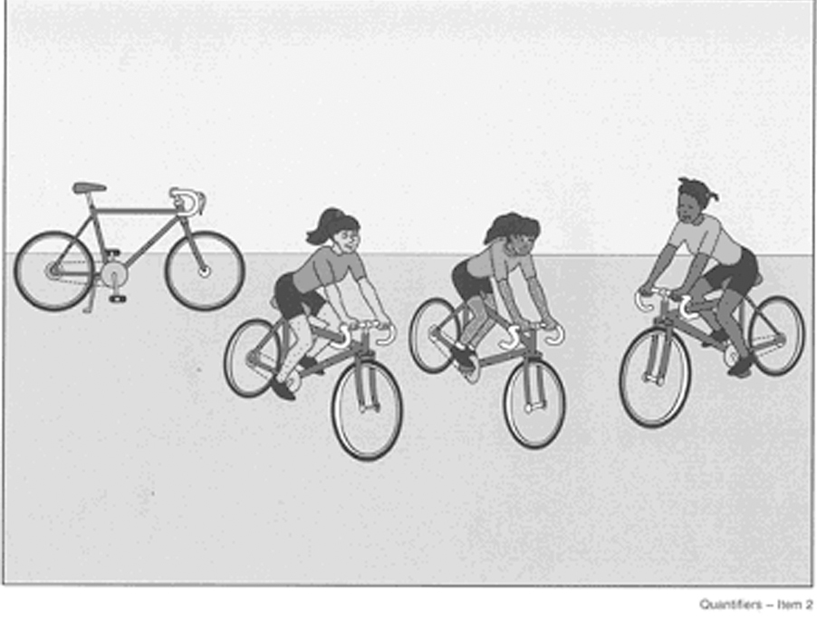
The phenomenon: 1. Classic spreading
Is every girl riding a bicycle?
No, not that one.

Slide 3
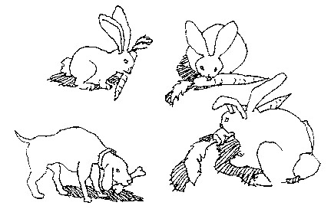
2. Bunny spreading
Is every bunny eating a carrot?
No, not that one.

Slide 4
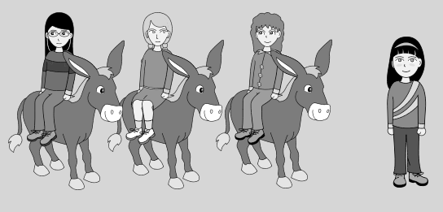
Underexhaustive search is a different phenomenon:
Is every girl riding a donkey? Yes.
Cause:
failure to pay attention; affirmative response strategy

Slide 5
Theories of Quantifier Spreading
Cognitive explanation
Inhelder & Piaget (1958, 1964):
immature cognitive (logical) abilities, problems with categorization

Slide 6
Linguistic explanations: problem with the domain of quantification
Philip (1995): QS is quantification over (sub)events
Is every girl riding a bicycle? = ‘Is every subevent an event of a girl riding a bicycle?’
Counter-evidence:
spreading in non-eventive sentences:
Is every girl a bicycle rider?
No, not that one.

Slide 7
A parsing problem repaired by pragmatic processes:
Drozd&Loosbroek 1999, Drozd 2001, Geurts 2003:
Children treat universals as if they were weak quantifiers with no fixed domain. They supply the domain of quantification pragmatically.
Replacing (b) with (c):
Every boy is riding an elephant.
[ x: boy(x)] <every> [y: elephant(y), x rides y]
c. [ ... : ... ] <every> [x, y: boy(x), elephant(y), x rides y]

Slide 8
Counter-evidence: QS also occurs with weak (numerical) quantifiers
We found that 4 out of 32 children (12,5%) show systematic QS with numerical quantifiers. E.g.
Picture showing 3 girls riding bicycles, and an extra bicycle:
Three girls are riding a bicycle.
No, four.

Slide 9
Philip (2011): Relevance Account
Universal quantification triggers exhaustive enumeration verification, which activates symmetrical pattern recognition.
The missing object spoiling symmetry is salient for the child, who imagines it to be existent.
(1) Salient Object Strategy
If an object is contextually relevant, then it is salient.
(2) A missing agent that spoils a symmetrical pattern is salient.

Slide 10
The frequency of QS can be changed by manipulating the pragmatic conditions:
Richer linguistic context (Crain et al. 1996: condition of plausible dissent)
or richer visual context (Freeman et al. 1982:
more than one extra object, etc.)
or a backgrounded extra object
may reduce QS.

Slide 11
Hypothesis:
Children give non-adult-like answers because they consider all the elements in the visual stimulus relevant.
They assume that the icons represented in the pictures are all to be accounted for; their totality constitutes the domain of quantification.

Slide 12
Children are misled by their disposition to show preferential attention to ostensive signals.
Csibra & Gergely (2009), Gergely & Jacob (2012), Butler & Markman (2014), etc.:
Children encode the content of ostensive communication as representing relevant episodic information or generalizable knowledge.

Slide 13
Butler & Markman (2014): Preschoolers give more credit to ostensive demonstration than to salient perceptual clues
Three groups of preschoolers observed identical evidence presented accidentally, intentionally, and communicatively that a novel object had a certain property (magnetism).
They identified magnetism as an inherent property of the object only when it was demonstrated communicatively.

Slide 14
Claim:
When the visual stimulus in a sentence-picture matching task is a minimal model abstracting away from the details of the situation, children regard the elements of the stimulus as ostensive clues.
They assume that these ostensive clues represent and only the relevant elements to be matched with the sentence.

Slide 15
Experimental evidence
Objectives:
To show that if the visual stimuli consisting of a few icon-like elements are replaced by photos rich in accidental details,
they are not misunderstood as ostensive signals, and QS is radically reduced.

Slide 16
Participants:
XX children from 3 Budapest kindergartens,
Mean age XX, SD XX
Method:
Sentence-picture matching;
truth value judgement

Slide 17
Materials: 8 test sentences (+ 16 fillers), associated with an iconic drawing and a photo
Procedure:
Children divided into 2 groups.
Group A
judged sentences 1-4 associated with a drawing,
and sentences 5-8 associated with a photo.
Group B
judged sentences 1-4 associated with a photo,
and sentences 5-8 associated with a drawing.

Slide 18
An example:

Slide 19
Another example:

Slide 20
Results:

Slide 21
Adult control group:

Slide 22
Discussion:
QS is a consequence of misleading experimental methodology.
If the visual stimulus associated with a quantified sentence is a minimal model devoid of redundant details, the child tends to interpret all of its elements as ostensive clues figuring in the meaning of the sentence.
If the ostensive effect is diminished by the use of photos taken in natural environments, the proportion of QS is reduced by more than 50%.

Slide 23
Misleading ostensive effects in other types of language acquisition experiments
Testing scalar implicatures:
In a game, the child has pulled 4 identical cards.
Experimenter:
Those who have 3 identical cards get a balloon.
100% of children: Sorry, I don’t have three.
The child assumes that the numeral in the experimenter’s utterance must be interpreted on the domain constituted by all the elements on the stimulus card.

Slide 24
In a natural situation:
During a game, there are 4 glasses on the table.
Experimenter:
Please, pour us some water. Are there 3 glasses on the table?
85% of children: Yes, there are.

Slide 25
Conclusion:
In experiments testing children’s sentence interpretation, the stimuli are often misinterpreted as ostensive cues, as a consequence of which they elicit reactions that do not occur in natural circumstances.
The cause of misinterpretation can be the iconicity of the stimulus, or the test situation itself.

Slide 26
References:
Butler, L.P. & E.M. Markman 2014. Preschoolers use pedagogical cues to guide radical reorganization of category knowledge. Cognition 130.
Csibra, G., Gy. Gergely 2009. Natural Pedagogy. Trends in Cognitive Sciences 13, 148-153.
Drozd, K.F. 2001. Children’s weak interpretations of universally quantified sentences. In Conceptual Development and Language Acquisition, ed. M. Bowerman and S.C. Levinson, 340-376. CUP.
Geurts, B. 2003. Quantifying kids. Language Acquisition 11: 197-218.
Gergely, Gy., P. Jacob 2012. Reasoning about instrumental and communicative agency in human infancy. In Rational Constructivism in Cognitive Development, ed. T. Kushnir, 59–94. Academic Press.
Philip, W. 1995. Event quantification in the acquisition of universal quantification. PhD diss., Umass, Amherst.
Philip, W. 2011. Acquiring knowledge of universal quantification. In Handbook of Generative Approaches to Language Acquisition, ed. J. de Villiers, T. Roeper, 351-394. Dordrecht: Springer.

