Slide 1
The role of historical corpora in the reconstruction of proto-syntax
Katalin É. Kiss
Research Institute for Linguistics of the Hungarian Academy, and
Pázmány Péter Catholic University

Slide 2
Can proto-syntax be reconstructed?
Lightfoot (2002): No, because
there is no theory of linguistic change, as linguistic change is chaotic;
the comparative method is only applicable in the reconstruction of proto-lexemes.

Slide 3
Campbell and Harris (2002), Pires and Thomason (2008), A. Harris (2008), etc.:
yes, on the basis of regular syntactic correspondences of cognates in related languages, + directionality generalizations.
Von Mengden:
Yes, on the basis of implicational universals, and by undoing grammaticalization.

Slide 4
How to identify syntactic cognates?
Roberts & Roussou (2003), Longobardi (2003): Syntactic cognates: the parametric values of Universal Grammar.
Alice Harris (2008):
On the basis of functional, distributional and phonological correspondence.

Slide 5
A problem for establishing Uralic syntactic correspondence sets:
Hungarian and its closest sisters (the Ob-Ugric languages ) parted 3000-4000 years ago; they are too far.
Hungarian documents only since 1192-95.
Proposal: obtaining cognates for comparison
by extending backwards the ʃ curves of linguistic changes attested in the documented history of Hungarian.

Slide 6
The ʃ curve of linguistic changes:
The progress of a linguistic innovation over time forms an ʃ-curve (Osgood & Sebeok 1954, Weinrech, Labov & Herzog 1965, etc.)
The disappearing variant ( ʅ) represents the prevalent variant of the previous, undocumented phase of the language.

Slide 7
Obtaining evidence about Proto-Ugric and early Proto-Hungarian syntax :
Reconstructing late Proto-Hungarian structures by the backward extension of ʃ-curves of linguistic changes attested in the documented history of Hungarian;
finding cognates in reconstructed late Proto-Hungarian and in present-day Ob-Ugric (Vogul and Ostyak).
.

Slide 8
A case study: Reconstructing the word order of Proto-Hungarian
Hungarian has been Top Foc V X* throughout its documented history (since 1192-95).
E.g.
[_{TopP}oz gimilsnek_{i}[_{FP}vvl keseruv_{k}[_{VP}uola [t_{i} vize] t_{k}]]]
the fruit-dat so bitter was juice-3sg
’of the fruit, so bitter was the juice’
(Funeral Sermon 1192-95)

Slide 9
Arguments that Proto-Hungarian was SOV: Declining OV patterns, spreading VO patterns in the historical corpus
Declining S-curves:
Disappearing SOV clause types
Decreasing prehead participial relatives
Decreasing participial adverbial clauses
Decreasing infinitival complement clauses
Disappearing clause-final complementizer
Disappearing V-adjoined negative particle
Disappearing V-Auxiliary order

Slide 10
The declining structures must have prevailed in Proto-Hungarian.
They converge with corresponding structures of Vogul and Ostyak ->
They must represent Ugric heritage.

Slide 11
1. Disappearing SOV clause types
Ostyak and more distant sister languages:
Strictly SOV order; object is unmarked, e.g.:
(1) Juwan jik-ə-l pilna xo:p we:r-s-ə-ŋən.
Ivan son-3sg with boat make-past-ep-3d
‛Ivan made a boat with his son.’
(2)(luw) juwan re:sk-ə-s
he Ivan hit-ep-past.3sg
’He hit Ivan.’ (Nikolaeva 1999)

Slide 12
SOV non-finite clauses with an unmarked object in Old Hungarian:
Infinitival clauses:
(3) ne fordo’l’lon mˉg ǫ kǫntosǫ feluènni not turn-SUBJ-3SG back he gown-3SG-ø put.on-INF
‘he should not turn back to put on his gown’ (Munich C. a.1416)
Present participial clauses:
(4) Kiral lèuèli irokat
king letters-3SG-ø writing-PL-ACC
‘those writing the king’s letters’ (Vienna C. a.1416)

Slide 13
SOV non-finite clauses with an unmarked object in Old Hungarian:
Perfect participial clauses
(5) Agyad meg ymmar bewne zantnak
give-IMP back now sin-3SG-ø repented-DAT
‘give it back now to that repented his sin’
(Jókai C. a.1370)
Predicative participial clauses
(6) ky zent fferenczet lewlteuala egyhaz feprette
who St Francis-ACC found church-NOM sweeping ‘who found St Francis sweeping the church’
(Jókai C. a.1370)

Slide 14
SOV non-finite clauses with an unmarked object in Old Hungarian:
Adverbial participial clauses
(7) ky haluan legottan el mene
what-ø hearing immediately away went
‘which having heard, he immediately went
away’ (Jókai C. a. 1370)

Slide 15
Why was SOV with an unmarked object preserved in non-finite clauses?
Because Ugric languages displayed/display differential object marking, with only topical objects marked -> topic marking only in main clauses
Lightfoot (1991)’s degree-0 learnability: children identify/reanalyze the grammar of their mother tongue on the basis of root clauses ->
embedded clauses are more conservative

Slide 16
The fast decline of unmarked objects:
Codexes: tokens unmarked Os token/unm.O
Jókai C. a1370: 22 733 42 540
Munich C. a1416: 69 589 78 892
Apor C. a1416: 22 118 18 1382
Vienna C. a1416: 54 423 24 2268
Jordánszky C.
a. 1516: 200 185 16 12 511

Slide 17
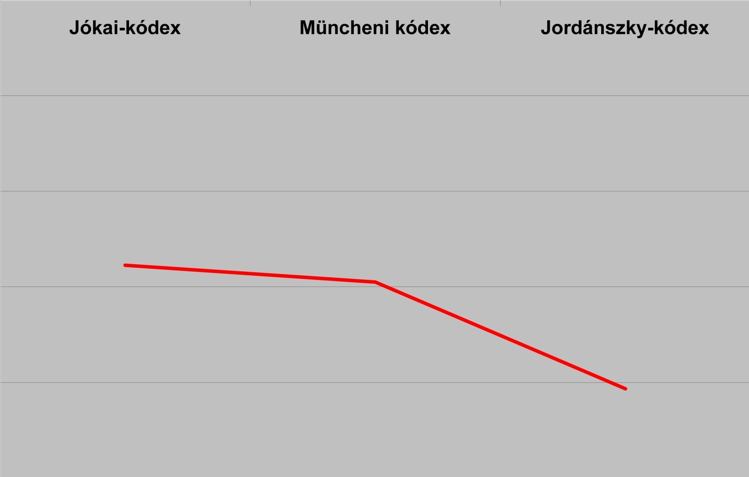
The decreasing proportion of unmarked objects

Slide 18
Accusative marking → VO order:
(8) Munich C. (a.1416) Matthew 4,20:
Azoc [legottan haloioc meghaguā] kǫuetec ǫtet
they immediately net-3PL-ø leaving followed him
‘Leaving their net immediately, they followed him’
(9) Jordánszky C. (a.1516):
Azok kedyg [legottan el hagywan haloyokat]
they however immediately off leaving net-3PL-ACC
es hayoyokat] kóweteek hewtet
and boat-3PL-ACC followed him

Slide 19
Fossilized OV structures with unmarked O in Modern Hungarian:
(10)
a. szava tartó ember
word-3SG-ø keeping man ‘a man keeping his word’
Mi tévő legyek?
what-ø doing be-1SG ‘What shall I be doing?’
b. esze vesztett ember,
mind-3SG-ø lost ‘ man ‘a man having lost his mind’
c. kalap levéve
hat-ø off-taking ‘taking off the hat’

Slide 20
2. Decreasing participial relatives
WALS: SOV -> prehead relatives; gap relativization
Ostyak: non-finite prehead relatives
(11) [(mä) tini-m-äm] loγ
I sell-PastPart-1SG horse
‘the horse which I sold’
(12) [Naŋ mo:sməlt-əm] o:xa:r-e:n jel an man-l
you wound-PastPart fox-2SG far not go-Pr.3SG
’The fox which you wounded does not go far.’

Slide 21
Old Hungarian participial relatives
(13) Es ueǵed az neko̗d zo̗rzo̗ttem Coronat
and take the you-DAT obtain-PP-1SG crown-ACC
‘and take the crown which I obtained for you’
(Kazinczy C. 1526)

Slide 22
Decreasing of gap relativization; increasing number of relative pronouns
Number of the relative pronouns who, what, which in St. Matthew’s Gospel:
Munich C. (a. 1416): 225
Jordánszky C. (a. 1516): 314
Károli Bible (1590): 330

Slide 23
Semi-productive gap relativization in Modern Hungarian:
(14)a. az [anyám sütötte] kenyér
the mother-1SG baked-PastPart-3SG bread
‘the bread which my mother baked’
b. egy [tanárok vezette] vetélkedő
a teachers administer-PastPart-3SG quiz
‘a quiz which teachers administered’
Only lexical subject, and 3SG agreement.

Slide 24
3. Decreasing non-finite adverbial clauses
WALS: SOV -> nonfinite adverbial clauses
Ostyak: only non-finite subordination
(15) [Kase:-m man-ti jupina] li-ti pit-l-əm
pain-1SG go-PART after eat-INF start-PRES-1SG
‘I start eating after my pain stops.’

Slide 25
Hawkins’s (2001) performance theory of word order
The Constituent Recognition Domain for a phrasal mother node consists of the set of nodes that are minimally needed to recognize its category, and its major constituents.
Optimal linear orders minimize the Constituent Recognition Domain. The shortest recognition domain for a matrix VP with a clausal complement contains the matrix verb and the subordinator.
In an SOV sentence, this domain is shortest if the subordinator is a participial suffix on the embedded verb, left-adjacent to the matrix verb.

Slide 26
Old Hungarian:
(16) [Nap kedig felkèluē] meg hèuọlėnc
sun coord rising Prt burned-past-3sg
’The sun having risen, they burned.’ (Munich C. a. 1416)
Middle Hungarian:
(17) Mykoron az nap fel tamadot wolna,
when the sun up rise-perf-3sg be-past
meg swte ewket
prt burn-past.3sg them
’When the sun had risen, it burned them.’
(Gábor Pesthi, Novum Testamentum 1536)

Slide 27
Decreasing number of non-finite adverbial clauses
Number of -ván/vén clauses in St Matthew:
Munich C. a. 1416: 486
Jordánszky C. a. 1516: 322
Károli Bible 1590: 286

Slide 28
4. Decreasing infinitival clauses
Ostyak: finite complement clauses only in the Russified speech of the young.
(18) [porniŋ imi juw-əm] wa:n-man taj-l-əlli
Por woman come-PastP see-PART have-Pr-3SG
‘She saw that a Por woman came.’
Infinitives with PRO subject:
(19) luw-e:l [ø man-ti] mo:sl
he-ACC leave-INF need-Pr3SG
‘He has to leave.’

Slide 29
Old H: a much larger set of Vs taking an infinitive clause than in Middle/Mod.H
Compare Matthew 14,19:
(20) És mikor parancsolt volna az gyölekezetnek
and when ordered AUX the crowd-DAT
‘And when he ordered the crowd’
a. leülni az szénán (Munich C. a1416)
down-sit-INF the grass-on
b. hogy le ülnénec az füuen (Károli Bible 1590)
that down sit-SUBJ-3PL the grass-on

Slide 30
5. Disappearing clause-final interrogative particle
SOV Vogul and Ostyak:
clause-final interrogative particle
(21)a. tit χujew-ä
here sleep.1pl-q
’Do we sleep here?’ (Vogul)
b. nèηem tǒttε ù.tot-á
wife-1sg there was-q
’Was my wife there?’ (Ostyak)

Slide 31
-e: a cognate interrogative particle in Old/Modern Hungarian
Old Hungarian: clause-final or V-adjoined -e:
(22) Nemdè kèt vèrèbec adatnac eģfel penzen ė?
not two sparrows give-pass-3pl half coin-on q
’Are not two sparrows sold for a farthing?’
(Munich C., Matthew 10,29)
(23) Il’l’es vag ė tè?
Elias are q you
’Are you Elias?’ (Munich C., John 1,21)

Slide 32
Middle/Mod. Hungarian: -e adjoined to the V (or to a preverbal element)
Jordánszky C. (a 1516)
(24) Nem de ket verebek adatnak ee
not two sparrows give-pass-3pl q
eǵ ffel penzen?
half coin-on
(25) yllyes vagy ee the?
Elias are q you

Slide 33
6. Disappearing V-adjoined negative particle
Ostyak: pre-V negative particle
(26) Tami naŋ ke:se:-n ant u:-l
this you knife-2SG NEG be-Pr.3SG
‘This is not your knife.’
(27) Niŋ ne:ŋxi an taj-əl
woman man NEG have-Pr.3SG

Slide 34
Old Hungarian: two negative constructions
PRT NEG V – with NEG left-adjoined to V:
(28) Rázódott nádat meg nem szeg (Munich C.)
bruised reed-ACC PRT not breaks
‘A bruised reed shall he not break’
(ii) NEG V … PRT – with V raised to NEG:
(29) És nem esmeré meg őtet (Munich C.)
and not knew PRT her
‘And knew her not’

Slide 35
Evidence of V-to-NEG movement in the innovative pattern:
(30)
[_{NegP} nem fyzettel_{i} [_{VP} telyesseguel [_{VP} meg t_{i}]]]
not paid completely up
’…you have not paid up completely’ (Jókai C.)

Slide 36
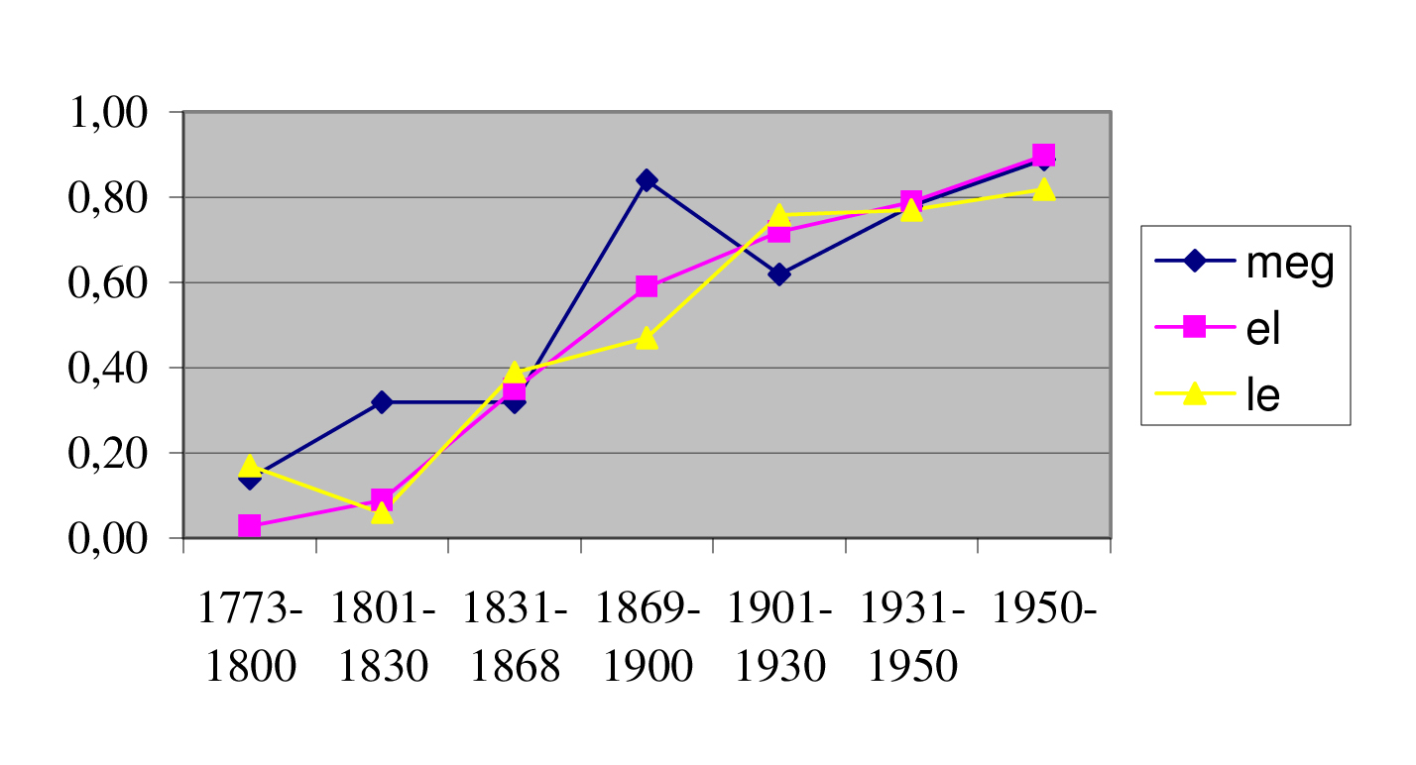
The increasing proportion of Neg V …PRT in the Modern Hungarian period (Gugán 2007)

Slide 37
7. Disappearing V-Auxiliary order
Old Hungarian complex tenses with a temporal aux. are cognate with Udmurt complex tenses
(Udmurt: a sister language. Hungarians and Udmurts shared a habitat in 600-700 AD)
Hun.men-ni Ud.mini-ni ‘go-INF’
megy-ek mini-sko ‘go-Pr.1SG’
megy-ek vala mini-sko val ‘go-PastCont.1SG’
ment-em min-em ‘go-PrPerf.1SG’
men-t-em vala min-em val ‘go-PastPerf.1SG’

Slide 38
Old Hungarian: complex tenses, strict V-Aux order
(31) És imé az czillag, mellyet láttac vala
and lo the star which-ACC see-PERF.3PL be-PAST
nap keleten, elöttöc mégyen vala
east-in before.them go-3SG be-PAST
‘And, lo, the star, which they had seen in the
east, was going before them’

Slide 39
Disappearing temporal auxiliary; present perfect reinterpreted as past
(32) És íme, a csillag, amelyet napkeleten
and lo the star which-ACC east-in
láttak, előttük haladt,
see-PAST.3PL before.them procede-PAST-3SG
(Neovulgata 1969)

Slide 40
Surviving auxiliaries: Aux-V order in the unmarked case
(33)
hogy ehsegtewl sok emberek fognak meg halny
that hunger-from many peple will-3pl prt die
’that many people will die from hunger’ (Jókai C. a. 1370)

Slide 41
Summary
Ostyak and Hungarian are too fare to contain cognates to be compared.
The backward extension of ʃ-curves created on the basis of historical corpora makes it possible to reconstruct late Proto-Hungarian syntax.
Late Proto-Hungarian and present-day Ostyak are close enough to reconstruct syntactic properties of their shared ancester.

