Slide 1
Stable variation and change in Hungarian negative sentences
Katalin Gugán
Research Institute for Linguistics, HAS
FWAV 4
30.06.2017.

Slide 2
Negation in Modern Hungarian
Two variants:
a) nem eszem meg: NEG – V – VM b) meg nem eszem: VM – NEG – V
Unequal distribution:
(a)-type: 1,071,219 vs. (b)-type: 11,150
(Kalivoda 2017) in the Hungarian National Corpus (785 M tokens)
Result of a radical change (19th century); prior to that: the MH standard variant was marginal

Slide 3
Overview
Structural description
Outline of the periods of stable variation (Old and Middle Hungarian) and change (Early Modern Hungarian) on the basis of one type of verbal modifier, the preverbal particle
Focus on the individual in the period of stable variation in order to find out what are the factors that influence the choices of the speaker(s)

Slide 4
Modern Hungarian (É. Kiss 2002, 2008)
Verb-initial VP
Postverbal word order: free
Preverbal section: functional projections (CP, TopP, DistP, FocP + NegP)
Neutral sentences: verbal modifiers (VM) are left-adjacent to the verb owing to movement to Spec, PredP
Non-neutral sentences (questions, sentences containing a focussed element, negative sentences): the VM is postverbal, as the verb moves to a higher functional position

Slide 5
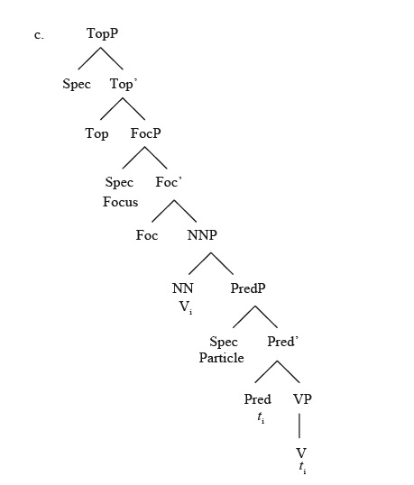
NegP
(É. Kiss 2008: 8.)

Slide 6
Verbal Modifiers: examples
VM category | Neutral sentence | Negative sentence
verbal prefix | el-olvas away read | nem olvas el not read away
bare nominal objects | könyvet olvas book read | nem olvas könyvet not read book
bare nominal subjects | vendég érkezett guest arrived | nem érkezett vendég not arrived guest
bare nominal oblique complements | ágyban maradt bed.Loc stay | nem maradt ágyban not stay bed.Loc
predicative nouns | tanár volt teacher was | nem volt tanár not was teacher
predicative adjectives | híres volt famous was | nem volt híres not was famous
bare indefinites | olvasni fog read will | nem fog olvasni not will read

Slide 7
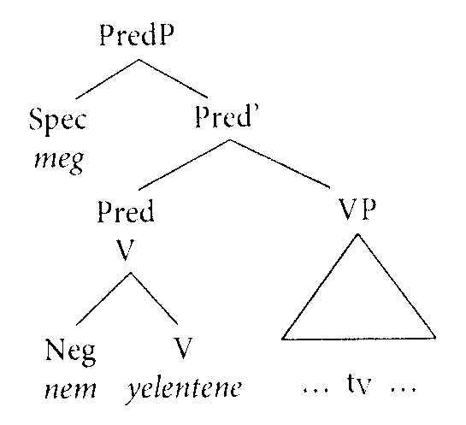
The diachronic background: negation (É. Kiss 2014)
Proto-Hungarian (1000 B.C. – 896 A.D.): S O Neg V
Ob-Ugric parallels
negative particle: left-adjoinded to the verb → VM – NEG - V (conservative pattern)

Slide 8
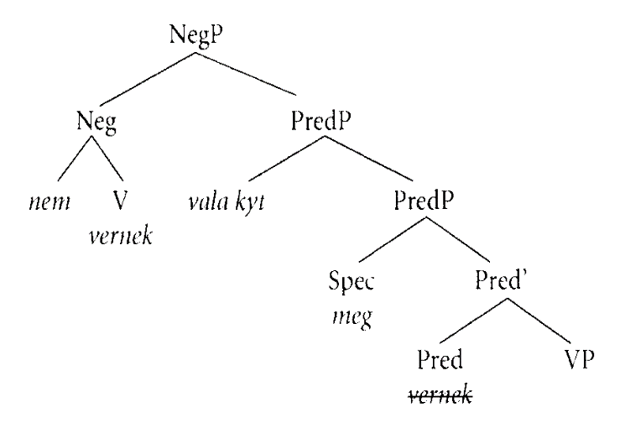
The diachronic background: negation (É. Kiss 2014)
Early Old Hungarian: the emergence of functional projections including NegP
Non-obligatory movement of the negated verb elicited by the Neg head → NEG-V-VM (innovative pattern 1.)

Slide 9
The diachronic background: negation (É. Kiss 2014)
Final step: reanalysis of the moved negated verb
Result: negative particle: base-generated under Spec,NegP; negated verb: movement elicited by the negative particle → NEG – V – VM (innovative pattern 2.)
Assumed reason for reanalysis: growing frequency of the optional movement

Slide 10
Factors assumed to influence speakers’ choice
Emergence of negative pronouns that incorporated the negative particle → if present, the scope of negation is marked (negative pronoun in Spec, NegP) → movement of the negated verb less frequently elicited (É. Kiss 2014)
A subset of adverbial clauses (hacsak ‘unless’, amíg ‘until’ : preserve the conservative order, although with dialectal variation. [Structure assigned to such adverbial clauses in ModH: VM in focus (Ürögdi 2012)]

Slide 11
I. Stable variation and change
Three periods (OH, MidH, Early ModH) on the basis of three corpora
VM here represented by (and restricted to) preverbal particles: the "baseline" of the category of Verbal Modifiers (it was their original preverbal argument position that was reanalyzed as a preverbal functional position, Hegedűs 2015)

Slide 12
Old Hungarian: background and sources
896–1526
Minor relics and 45 codices representing monastic culture (appr. 200–300 codices were lost during the Turkish occupation starting in 1526; Madas 2002)
Old Hungarian corpus: all the codices are digitalized, 13 of them are normalized, 5 of them are morphologically analyzed → query is only possible of normalized versions because of the lack of an established orthographical tradition
http://omagyarkorpusz.nytud.hu/en-search.html, Simon (2014)
Data stem from the normalized codices + some manual search

Slide 13
Old Hungarian: stable variation and an exception
conservative pattern innovative pattern N = 503

Slide 14
The mistery of the Hussite Bible
Three 15th-century codices: Munich, Bécsi (Vienna), and a part of Apor: copies (or copies of copies) of a lost translation of the Bible, the three codices containing different parts of this lost translation
Vienna: preference of the innovative pattern, Munich: preference of the innovative pattern (observed by Hegedűs 2015)
Apor:
Apor-codex | conservative | percent | innovative | percent
2. hand (Hussite) | 8 | 0,14 | 50 | 0,86
3. hand (non-Hussite) | 8 | 0,89 | 1 | 0,11

Slide 15
Middle Hungarian: background and sources
Symbolic boundaries: 1526 and 1772
Turkish occupation, decay of monastic culture, loss of speakers and sources
Corpus of Historical Hungarian Informal Texts: 750,000 tokens (and counting); fully normalized and morphosyntactically annotated + additional sociolinguistic information
containing testimonies of witnesses in witch trials (52.5%) and samples of private correspondance (47.5%) → serfs vs. noblemen
http://tmk.nytud.hu/, Novák et al. 2017.

Slide 16
Socio-cultural bacground: irrelevant
trials (N = 1128)
letters (N=687)
conservative pattern innovative pattern N = 1815

Slide 17
Dialectal background: irrelevant
Counties
Regions

Slide 18
Early Modern Hungarian
A largely overlooked period; if mentioned, then focus on the language reform movement
Source: HHC (Sass 2017) – 30 M tokens, but neither normalized nor morphologically analyzed (though orthography in that period was already a bit more stable than in OH and MidH)
Focus on one preverbal particle, meg: original meaning (backwards) lost due to grammaticalization; the only preverbal particle that does not have a directional meaning
Query for character string nem with meg in its immediate environment, results filtered manually

Slide 19
Late Middle and Early Modern Hungarian data: meg in negative sentences
N=7987

Slide 20
period | conservative, N | cons., % | innovative, N | inn., %
1701-1710 | 56 | 0,84 | 11 | 0,16
1711-1720 | 129 | 0,83 | 26 | 0,17
1721-1730 | 95 | 0,86 | 16 | 0,14
1731-1740 | 75 | 0,86 | 12 | 0,14
1741-1750 | 149 | 0,87 | 22 | 0,13
1751-1760 | 69 | 0,90 | 8 | 0,10
1761-1770 | 10 | 1,00 | 0 | 0,00
1772-1780 | 57 | 0,81 | 13 | 0,19
1781-1790 | 201 | 0,90 | 23 | 0,10
1791-1800 | 333 | 0,91 | 31 | 0,09
1801-1810 | 205 | 0,76 | 64 | 0,24
1811-1820 | 170 | 0,75 | 56 | 0,25
1821-1830 | 212 | 0,76 | 66 | 0,24
1831-1840 | 182 | 0,60 | 121 | 0,40
1841-1850 | 407 | 0,52 | 374 | 0,48
1851-1860 | 198 | 0,47 | 224 | 0,53
1861-1870 | 174 | 0,45 | 214 | 0,55
1871-1880 | 154 | 0,40 | 234 | 0,60
1881-1890 | 153 | 0,37 | 257 | 0,63
1891-1900 | 133 | 0,36 | 235 | 0,64
1901-1910 | 150 | 0,30 | 348 | 0,70
1911-1920 | 118 | 0,23 | 406 | 0,77
1921-1930 | 147 | 0,23 | 481 | 0,77
1931-1940 | 195 | 0,17 | 973 | 0,83

Slide 22
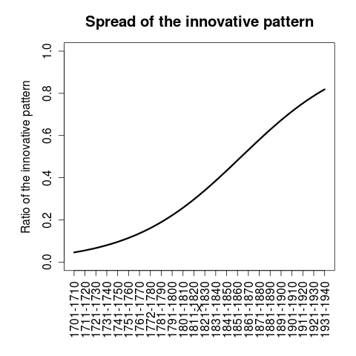

Slide 23
Interim conclusions
Over four centuries of stable variation, the innovative pattern is below (or well below) 20% until the beginning of the 19th century
Exception: the dialect represented in the Hussite Bible – this dialect might have disappeared during the Turkish occupation
Assumption: emergence of innovative pattern1 precedes Old Hungarian, but the new structure must have acquired a specific function, and this is responsible for stable variation
Specific function (triggering movement of the negated verb): unknown → focus on the individual

Slide 24
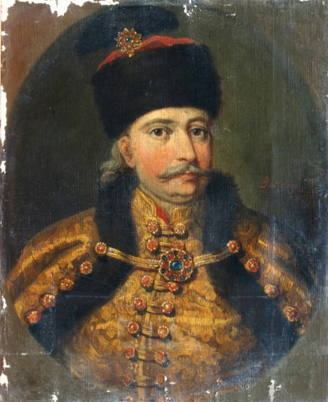
II. Focus on the individual in the period of stable variation
Letters of Sándor Károlyi (1669-1743) written to his wife, Krisztina Barkóczy until her death in 1724
a member of one of the oldest and richest noble families
born in the North-Eastern part of Hungary and spent his (quite rough) childhood there
data from TMK: the query resulted in 2535 instances of the negative particle, manual analysis, 666 of these contained a VM

Slide 25
Factors
(presence or absence of verbal modifier)
dependent variable: negative pattern (conservative / innovative / type3)
independent variables: - type of VM - clause type1: declarative / question / embedded question - clause type2: main / subordinate finite / non-finite / (focus negation) - presence or absence of negative pronoun

Slide 26
Methods and results
overall result:
if VM = verbal prefix, 87% vs. 13%
type 3: NEG-VM-V, below 1%, only among adjectival verbal modifiers
following Gries (2003, 2013, 2014): R, monofactorial analyses (ultimate goal: multifactorial analysis)
24%

Slide 27
Type of the verb modifier
 | a_suff | adj | adv | bn | DP_suff | n_px | n_suff | nom | pron_suff | pv | tba
conservative | 3 | 14 | 45 | 36 | 7 | 7 | 50 | 32 | 7 | 289 | 9
innovative | 4 | 17 | 15 | 3 | 6 | 20 | 15 | 32 | 3 | 42 | 5
type3 | 0 | 5 | 0 | 0 | 0 | 0 | 0 | 0 | 0 | 0 | 0

Slide 28
Simplifying the category of VM
some types are rare → random variation
other types are quite similar → not necessary to use so many categories
pairwise comparisons
Sentences expressing clausal possession were left out (problematic whether the possessed noun is a VM at all)
result: two categories, adj (45%) and nom (50%) vs. bn (92%), pv (87%), n_suff (77%) and adv (75%)
Ultimately, verbal predicaton vs. nominal predicaton

Slide 29
Negative pronoun
 | NEG.PRON
NEG.TYPE | none (N) | none (%) | present (N) | present (%)
conservative | 482 | 0.76 | 17 | 0.71
innovative | 155 | 0.24 | 7 | 0.29
The difference is not significant.

Slide 30
Clause type
 | main | non-finite | fin.sub.
conservative | 203 | 23 | 270
innovative | 89 | 18 | 44

Slide 31
Clause type
Significant difference between the categories
Main clauses pattern with non-finite clauses in featuring the innovative pattern more frequently, whereas finite subordinate clauses prefer the conservative pattern
Quite an unexpected result – the category is not fine-grained enough

Slide 32
Non-finites
Three types attested: converb, infinitive, action nominals
Infinitives, action nominals: almost exclusively with the conservative pattern
Converb: majority of the innovative pattern a) finite-like properties in the given period b) many instances of lévén, the converbial form of the copula
 | conv | inf | nom
conservative | 7 | 11 | 4
innovative | 17 | 1 | 0

Slide 33
Subordinate sentences
Adverbial clauses, that-clauses and relative clauses with numerous subtypes (some with few data)
amíg (until)-clauses: 21/0, hacsak (unless): 23/2, ha (if) 76/3 vs. hogy (that) 42/13 and deleted hogy (28/13)
? Combinations: until- and if-clauses: the preference of the conservative pattern overrides the preference of the innovative pattern of nominal clauses
Multifactorial analysis needed

Slide 34
The grey zone
Levels that prefer the innovative order: nominal predication (+? converbs, main clauses)
Levels that prefer the conservative order: verbal predication, certain type of adverbial clauses
-- these can be explained.
But: there is still a large number of cases when there is seemingly arbitrary variation. Functional difference – emphasis?

Slide 35
A clue: the particle is
Additive particle:
János is elment. János too left.
Clausal addition:
János el akart menni,
‘ John wanted to go, és el is ment.
and away too went.
and he did go, too.’
János nem akart elmenni,
‘János did not want to go,
és nem is ment el. and not too go away.
and he did not go, either.’

Slide 36
A clue: the particle is
Few examples (negative clauses which contain both a VM and this particle)
Innovative pattern: the clitic almost exclusively follows the negative particle, conservative pattern: follows the VM-NEG-V complex
 | NEG-is-V-VM | VM-NEG-V-is | NEG-V-VM-is
conservative | 3 | 12 | 0
innovative | 11 | 1 | 1

Slide 37
A clue: the particle is
VM-NEG-V-is: typically in conditional and concessive clauses (which strongly prefer the conservative pattern); conditional subordinator + V-is: concessive conditional Ha Hellenbach meg nem veszi is, fejér pinzt is adnak azért mások is, ‘ Even if Hellenbach does not buy it, some others will give money for it.’
NEG-is-V-VM: typically in main clauses -- emphatic negation? aval mindjájan consuláltatni fogunk, nem is lesz különben. ‘ We will have consultations with that, it will not be differently.’
Similar pattern: csak ‘only’ + NEG – only with the innovative order, but even fewer examples

Slide 38
Conclusions
Although the evidence is scant, the innovative variant in the period of stable variation could be a more emphatic way of expressing negation
Loss of emphatic interpretation, generalization of verb movement, reanalysis of the structure – in some kind of causal relationship
Further, extra- / intralinguistic factors – for further research

Slide 39
Acknowledgements
Veronika Hegedűs, Katalin É. Kiss, Katalin Mády, Zoltán Gáspári
Competing structures in Middle Hungarian vernacular: a variationist approach, OTKA 116217
Hungarian Generative Diachronic Syntax 2., OTKA 112057

Slide 40
References
É. Kiss, Katalin. The Syntax of Hungarian. Cambridge, CUP.
É. Kiss, Katalin 2008. Aims and background. In: É. Kiss, Katalin (ed), Event Structure and the Left Periphery: Studies on Hungarian. Dordrecht, Springer.
É. Kiss Katalin 2014. The evolution of functional left peripheries in the Hungarian sentence. In: É. Kiss, Katalin (ed), The evolution of functional left peripheries in Hungarian syntax. Oxford, OUP.
Gries, Stefan Thomas 2003. Multifactorial Analysis in Corpus Linguistics: A Study of Particle Placement. New York / London, Continuum.
Gries, Stefan Thomas 2013. Statistics for Linguistics with R: A Practical Introduction. Berlin / Boston, De Gruyter Mouton.
Gries, Stefan Thomas 2014. Frequency tables: Tests, effect sizes, and explorations. In: Glynn, Dylan – Robinson, Justyna A. (eds), Corpus Methods for Semantics: Quantitative Studies in Polysemy and Synonymy. Amsterdam / Philadelphia, John Bejnamins.
Hegedűs, Veronika (2015). A predikátummozgatás megszilárdulása: Az ige-igekötő szórend és igemódosítók az ómagyarban. In: Kenesei, István – É. Kiss, Katalin (eds), Általános Nyelvészeti Tanulmányok XXVII: Diakrón mondattani kutatások. Budapest, Akadémiai Kiadó.
Kalivoda 2017 [MS]. Az igekötős igék szintaxisa korpuszvezérelt megközelítésben
Madas Edit 2002. Magyar nyelvű kódexirodalom (1440—1530) http://www.corvina.oszk.hu/studies/madas2002-1-hun.htm

Slide 41
Corpora
Old Hungarian Corpus
http://omagyarkorpusz.nytud.hu/en-intro.html
Simon, Eszter 2014. Corpus building from Old Hungarian codices. In: Katalin É. Kiss (ed.) 2014.
Corpus of Hungarian Historical Informal Texts
http://tmk.nytud.hu/
Novák, Attila – Katalin Gugán – Mónika Varga – Adrienne Dömötör 2017. Creation of an annotated corpus of Old and Middle Hungarian court records and private correspondence. Language Resources and Evaluation 51: 1—28.
Hungarian Historical Corpus
http://clara.nytud.hu/mtsz/run.cgi/first_form
Sass, Bálint 2017. Keresés korpuszban: a kibővített Magyar történeti szövegtár új keresőfelülete. In: Forgács Tamás – Németh Miklós – Sinkovics Balázs (szerk), A nyelvtörténeti kutatások újabb eredményei IX. SZTE Magyar Nyelvészeti Tanszék. Szeged.

Slide 42
Thank you for your attention!
Köszönöm a figyelmet!

