Slide 1

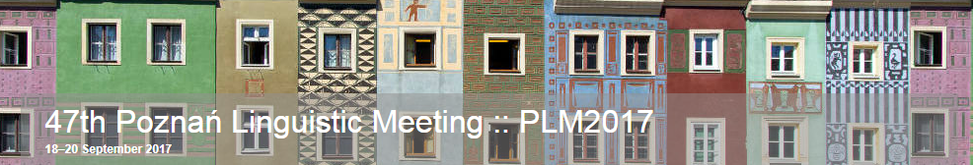
Laryngeal Relativism predicts Italian
Katalin Balogné Bérces & Bálint Huszthy
Pázmány Péter Catholic University, Budapest, Hungary
berces.katalin@btk.ppke.hu
huszthy.balint@gmail.com

Slide 2
Roadmap
two-way laryngeal systems
“laryngeal realism”: [voice] languages vs. [spread glottis] / aspiration languages ~ Element Theory: L-systems vs. H-systems
“laryngeal relativism” (E. Cyran): both the marked and the unmarked sets may receive any (more or less arbitrary) phonetic interpretation
proposal#1 (Balogné Bérces – Huszthy 2017, Balogné Bérces 2017): “classical” aspiration languages do not fit into Cyran’s typology -> three subtypes of binary laryngeal systems: L-systems vs. H-systems vs. unmarked systems (h-systems)
proposal#2: Italian is an h-system

Slide 3
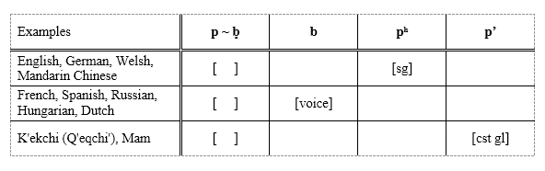
Two-way laryngeal contrasts in obstruents
+ three- and four-way contrasts (Thai, Korean; Hindi)

Slide 4
Aspiration vs. voice lang’s
traditional Generative Phonological view: the phonetic manifestation of an underlying voiceless vs. voiced distinction
“the narrow interpretation of [voice]” or “laryngeal realism” (e.g., Honeybone 2005, Iverson & Salmons 2008): spread glottis/aspiration lang’s vs. voice lang’s
the difference is primarily phonological: two totally different phonological mechanisms – in voice lang’s the [voice] feature is phonologically active (-> assimilation processes), in aspiration lang’s no signs of any laryngeal activity are detectable (cf. Huber & Balogné Bérces (2010) and elsewhere)

Slide 5
Aspiration vs. voice lang’s
the difference is primarily phonological: the presence/absence of phonological behaviour (in our case, RVA) implies the presence/absence of the representation of some phonological agent (in our case, some laryngeal prime/component)
English: match [-tʃ] + box [b̥-] -> matchbox [-tʃb̥-] vs.
Hungarian: matchbox [-dʒb-] ‘small toy car’

Slide 6
“Laryngeal relativism”
Cyran (various publications, e.g., 2014)
as long as a sufficient phonetic distance is kept between the two sets of obstruents to maintain phonological contrast (“sufficient discriminability in production and perception”), both the marked and the unmarked sets may receive any (more or less arbitrary) phonetic interpretation
phonetic interpretation is partly systemic (phonological)

Slide 7
“Laryngeal relativism”
it may even be the case that two laryngeal systems which are phonetically identical stem from two phonological settings in which the marked / unmarked relation is reversed
Polish: Warsaw Polish (WP) vs. Cracow Polish (CP)
differ phonologically but are phonetically identical in terms of laryngeal features:
WP: “classical” [voice] system (analysed as an “L-system” by Cyran): L-spreading
CP: “H-system”, with phonologically active H: H-spreading

Slide 8
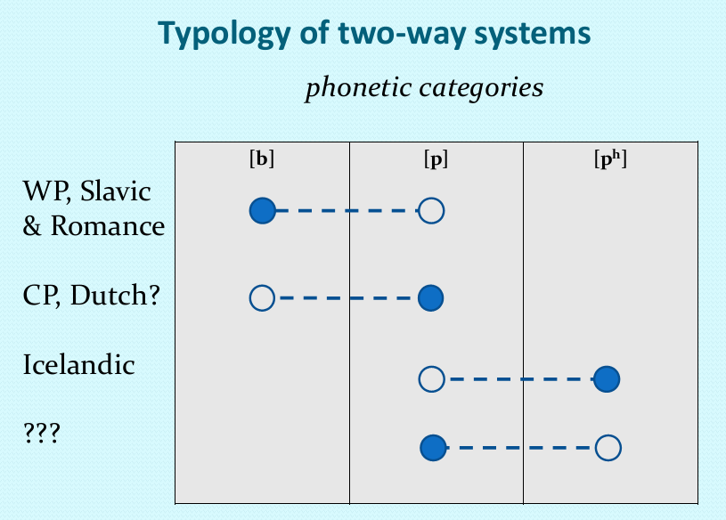
Cyran (2016)

Slide 9
“Laryngeal relativism”
re-defines the category of H-systems: active H that spreads
but: recall: in their “classical” version, e.g., in (standard) English and German, no laryngeal activity in the form of any kind of spreading is attested – suggesting the absence of any laryngeal element (following Huber & Balogné Bérces 2010)
-> we arrive at a typology with three systems:

Slide 10
Three subtypes of binary laryngeal systems
the absence of a source element
L in the marked series of obstruents
H in the marked series of obstruents

Slide 11
a) the absence of a source element: h-systems
(true) aspiration languages like English and German
fortisness/aspiration is dominant obstruency (h) dependent on licensing, i.e., on prosodic position (Huber & Balogné Bérces 2010)
no laryngeal spreading
the lenis series undergoes passive voicing

Slide 12
a) the absence of a source element: h-systems

Slide 13
a) the absence of a source element: h-systems
plus: “laryngeal relativism” predicts languages in which the lenis series is phonetically voiced -> account for Swedish (“the [voice] fallacy of [sg] languages” – Balogné Bérces & Huber 2010)
Swedish simply “overshoots” the phonetic distance required for discriminability

Slide 14
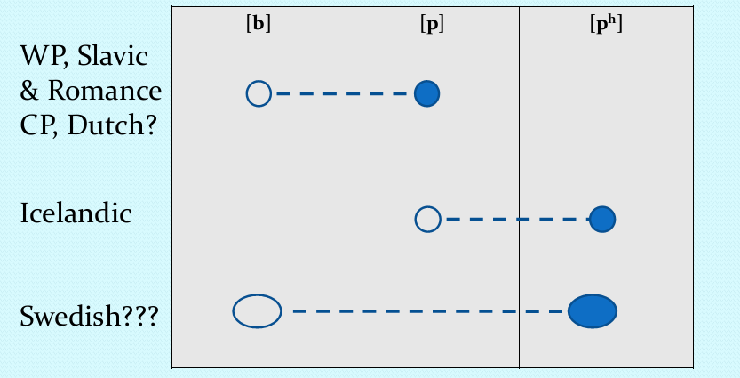
a) the absence of a source element: h-systems
Cyran (2016), incorporating van der Hulst (2015)

Slide 15
b) L in the marked series of obstruents
(true) [voice] languages/L-systems like Warsaw Polish, French or (Standard) Hungarian, in harmony with Cyran

Slide 16
c) H in the marked series of obstruents
(Cyran’s) H-systems, i.e., languages like Cracow Polish
H-spreading only
Balogné Bérces (2017): “Yorkshire Assimilation”
in harmony with Cyran, if such languages also have final obstruent delaryngealisation, they also exhibit cross-word passive voicing manifested in “pre-sonorant voicing” (cf. Slovak, Catalan, Southern Dutch/West Flemish, Ecuadorian Spanish)

Slide 17
Italian
Laryngeal Relativism also predicts the existence of, e.g., h-systems with virtually no aspiration in the fortis series
this is indeed the laryngeal characterisation of Italian
Italian: Romance + phonetics -> generally considered as an L-language
deficient phonotactics of the native vocabulary: laryngeal activity proper cannot be detected due to the absence of obstruent clusters
our data (Huszthy in prep.): potential feature spreading situations, elicited in loanword and foreign accent settings

Slide 18
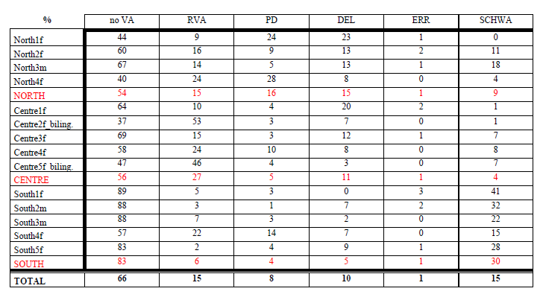

Slide 19
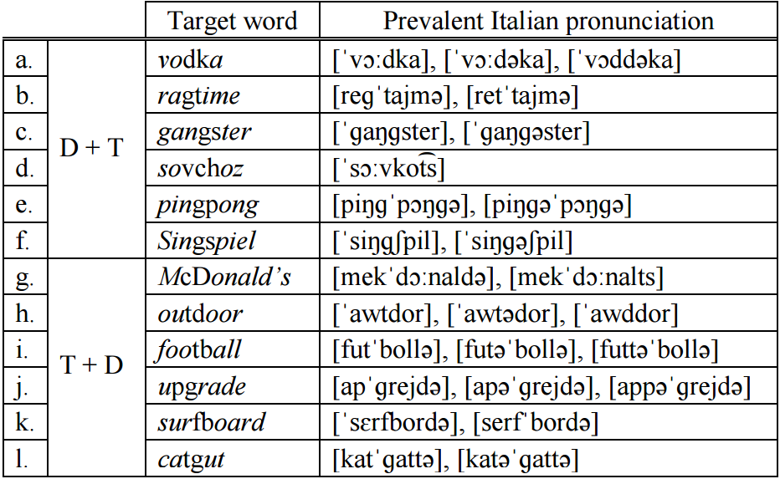
Italian

Slide 20
Italian
substantial voicing of lenis and voicelessness of fortis, but:
“RVA”: 15% only (mostly devoicing; voicing RVA in 4% only) + “Progressive Devoicing” (PD): 8% (North: 16%) – very much like in, e.g., English
analysis: no RVA
the voicing present in the lenis set is fundamentally passive voicing, maintained in sonorant environments and frequently lost next to a fortis obstruent (= “devoicing RVA” / “PD”)

Slide 21
Italian
phonologically: no true laryngeal activity (no assimilation/spreading) => in our present system, it is an h-language
fortis: a degree of overall aspiration that falls between the standard values of “ordinary” L-systems like Slavic/Hungarian and h-systems like (standard) English: /p/: 24 ms /t/: 27 ms /k/: 46 ms
That is, it seems to be an h-system with virtually no aspiration in the fortis series – an option actually predicted by “laryngeal relativism”

Slide 22
Conclusion
“laryngeal relativism” clarifies the relation btw. phonological system and phonetic realisation (“sufficient discriminability in production and perception”) and explains how two different systems may receive identical phonetic interpretation
the present paper: adds the insight of Huber & Balogné Bérces (2010, etc.) concerning representations in aspiration languages
-> proposal: three subtypes of binary laryngeal systems: L-systems vs. H-systems vs. unmarked systems (h-systems)
Italian is an h-system

Slide 23
Conclusion
Although our careful acoustic analysis has detected a degree of overall aspiration in the fortis series that falls between the standard values of “ordinary” L-systems like Slavic/Hungarian and h-systems like (standard) English, we contend that primary evidence is to be sought in phonological behaviour, which is arbitrarily related to phonetic realisation – in Italian very much like in the Cracow dialect of Polish.

Slide 24
Conclusion
Italian: Northern/central vs. southern
The data from our southern informants exhibit repair strategies in the case of input obstruent clusters preventing output clusters (e.g., schwa epenthesis) to such an extent that still deprives us of sufficient empirical evidence of the laryngeal phonology of these varieties

Slide 25
Future research
we assume that 3- and 4-way systems (Thai, Korean; Hindi) can be accounted for in a similar vein
binary systems based on constricted glottis (e.g., K'ekchi)

Slide 26
References
Balogné Bérces, K. & D. Huber. 2010. Naughty or nice? or: Why Swedish and Dutch are well-behaved Germanic languages. Poster, The Eighteenth Manchester Phonology Meeting, 20–22 May 2010.
Balogné Bérces, K. & B. Huszthy. 2017. The “real” and “relative” typology of binary laryngeal systems. 2nd Budapest Linguistics Conference (BLINC2), ELTE, Budapest, 1-3 June 2017.
Balogné Bérces, K. 2017. Binary laryngeal systems in a privative model of melodic representations. 15es Rencontres du Réseau Français de Phonologie (RFP2017), Grenoble, 5-7 July 2017.
Cyran, E. 2014. Between phonology and phonetics: Polish voicing. Studies in Generative Grammar 118. Berlin: Mouton de Gruyter.
Cyran, E. 2016. Laryngeal Relativism. Why? And what now?. Paper presented at OCP13, Budapest.
Honeybone, P. 2005. Diachronic evidence in segmental phonology: the case of obstruent laryngeal specifications. In van Oostendorp, M. & van de Weijer, J. (eds.) The internal organization of phonological segments. Berlin: Mouton de Gruyter. 319-354.
Huber, D. & K. Balogné Bérces. 2010. [voice] and/versus [spread glottis] in the modified Leiden model. Acta Linguistica Hungarica 57.4: 444-457.
van der Hulst, H. 2015. The laryngeal class in RcvP and voice phenomena in Dutch. In J. Caspers, Y, Chen, W. Heeren, J. Pacilly, N. Schiller & E. van Zanten (eds.) Above and beyond segments. Experimental linguistics and phonetics. Amsterdam: John Benjamins. 323–349.
Huszthy, B. In prep. How can Italian phonology lack voice assimilation? Doctoral dissertation, PPCU, Budapest.
Iverson, G. K. & J. C. Salmons. 2008. Germanic aspiration: phonetic enhancement and language contact. Sprachwissenschaft 33. 257-278.

Slide 27
