Slide 1




Ungrounded phonology
2013
Gósy, Mária and Siptár, Péter
Research Institute for Linguistics, HAS
and Eötvös Loránd University,
Budapest, Hungary

Slide 2
Introduction
Distinctive feature values attributed to the phonological segments of a language are normally based, in the unmarked case, on their phonetic properties (height, backness, rounding, length, etc. in the case of vowels).
This is sometimes referred to as their phonetic ‘grounding’ (see Archangeli & Pulleyblank 1994).
Some phonetic properties may on occasion turn out to be phonologically irrelevant.
The corresponding feature values may remain unspecified (and the specification of the properties concerned left for ‘phonetic implementation’).

Slide 3
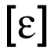




Introduction
The Hungarian nonhigh unrounded front vowels and exhibit regular length alternation with one another, despite the difference in height.
One possibility for keeping the length alternation regular is to leave the value for the feature [low] unspecified, and correspondingly symbolize these segments as (Siptár & Törkenczy 2000).
Regular vowel harmony alternation is found between and low back slightly rounded ; here, it is the rounding of the back vowel that can be seen as phonologically irrelevant, and the vowel pair can be symbolized as , / / (Törkenczy 2011).

Slide 4



Introduction
It would be expected to be quite impossible that the phonological behavior and phonetic character of a vowel be downright irreconcilable, rather than the two sets of properties being in a proper subset relation.
Hungarian provides an intriguing example of this supposedly impossible situation, too.
The long counterpart of / /, often symbolized as , is a regular back vowel in terms of its vowel harmony behavior (alternating with / /).
But, as has been repeatedly pointed out, its phonetic backness value seems to have been moving recently towards the front of the oral cavity.

Slide 5
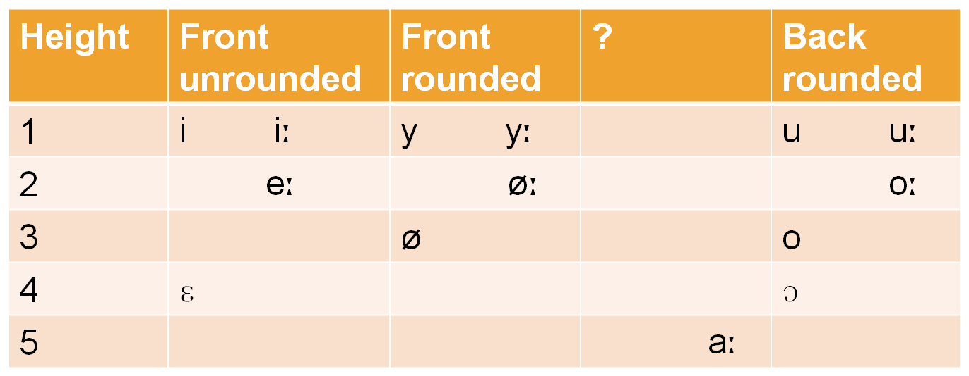
The Hungarian vowel system

Slide 6
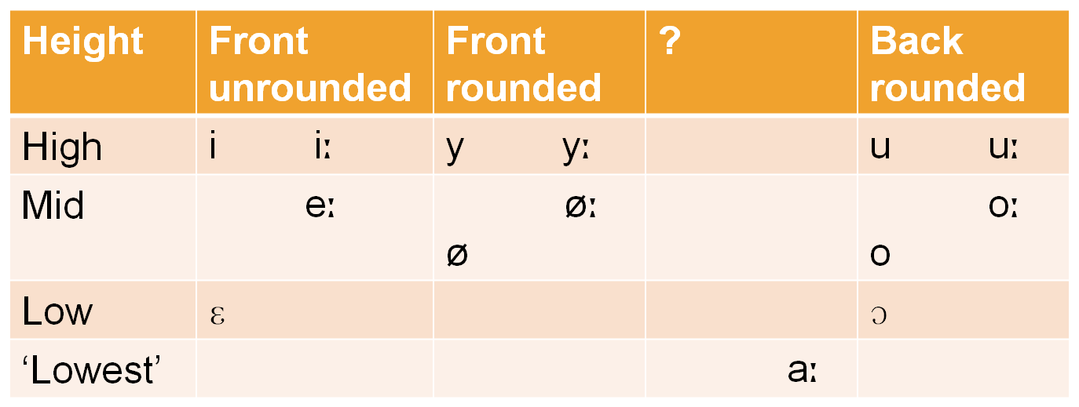
The Hungarian vowel system

Slide 7
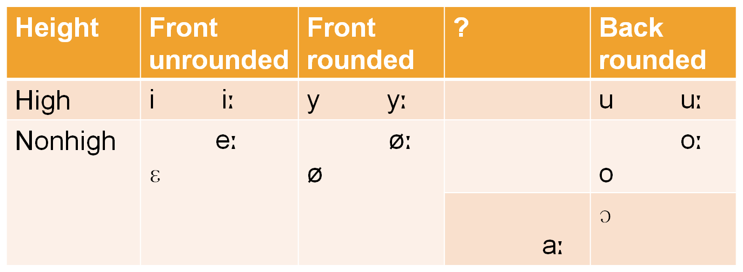
The Hungarian vowel system

Slide 8
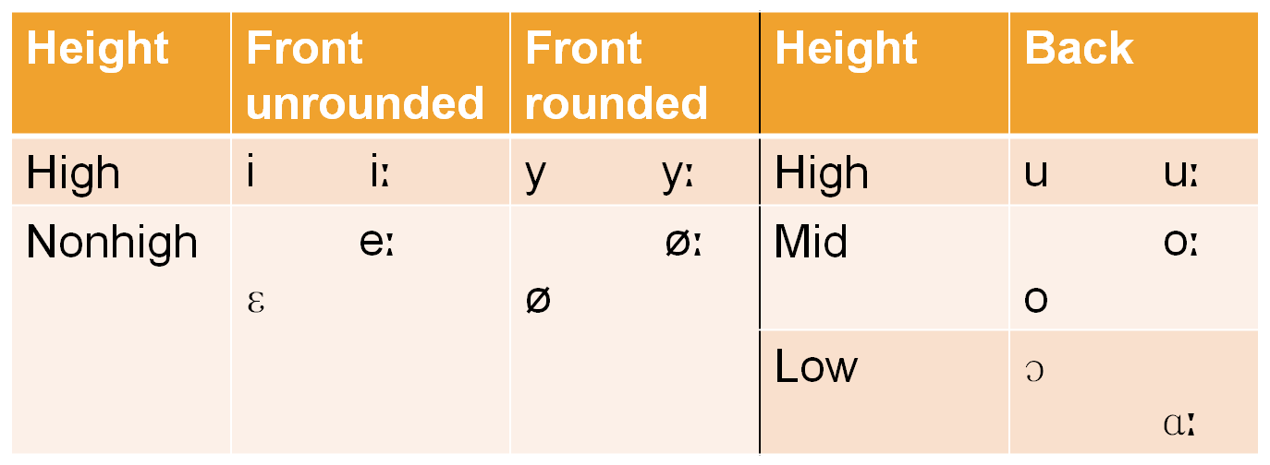
The Hungarian vowel system

Slide 9
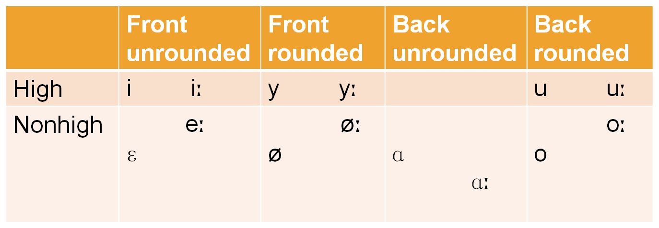
The Hungarian vowel system

Slide 10
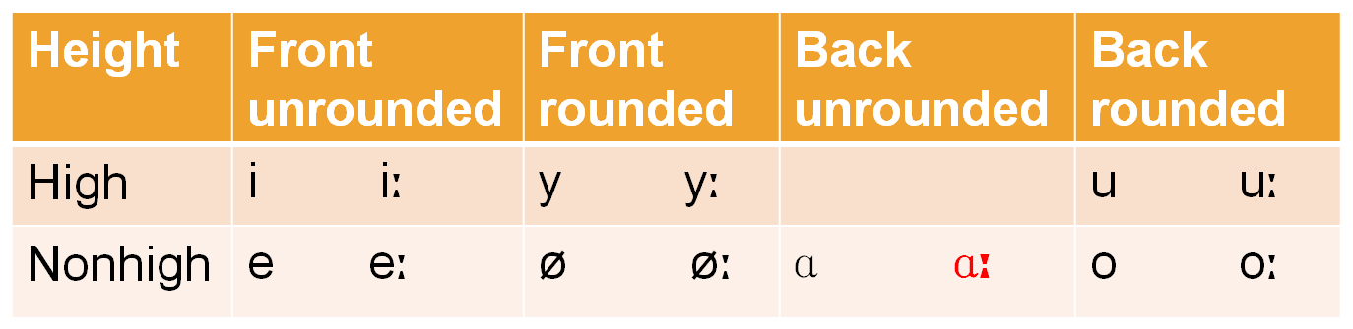
The Hungarian vowel system

Slide 11

Aim and hypothesis
The aim of this study is to shed light on the relevant acoustic structure of the vowel / /, and to discuss the implications for its phonetic and phonological classification.
Hypothesis:
There is an ongoing change taking place in the articulation of the vowel / /, affecting the horizontal position of the tongue in the oral cavity.

Slide 12
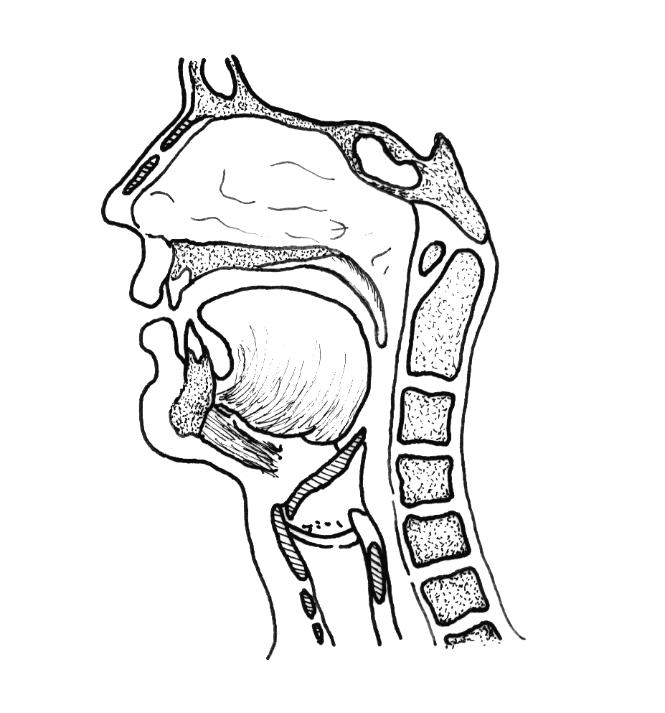
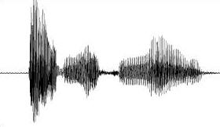
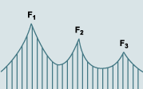
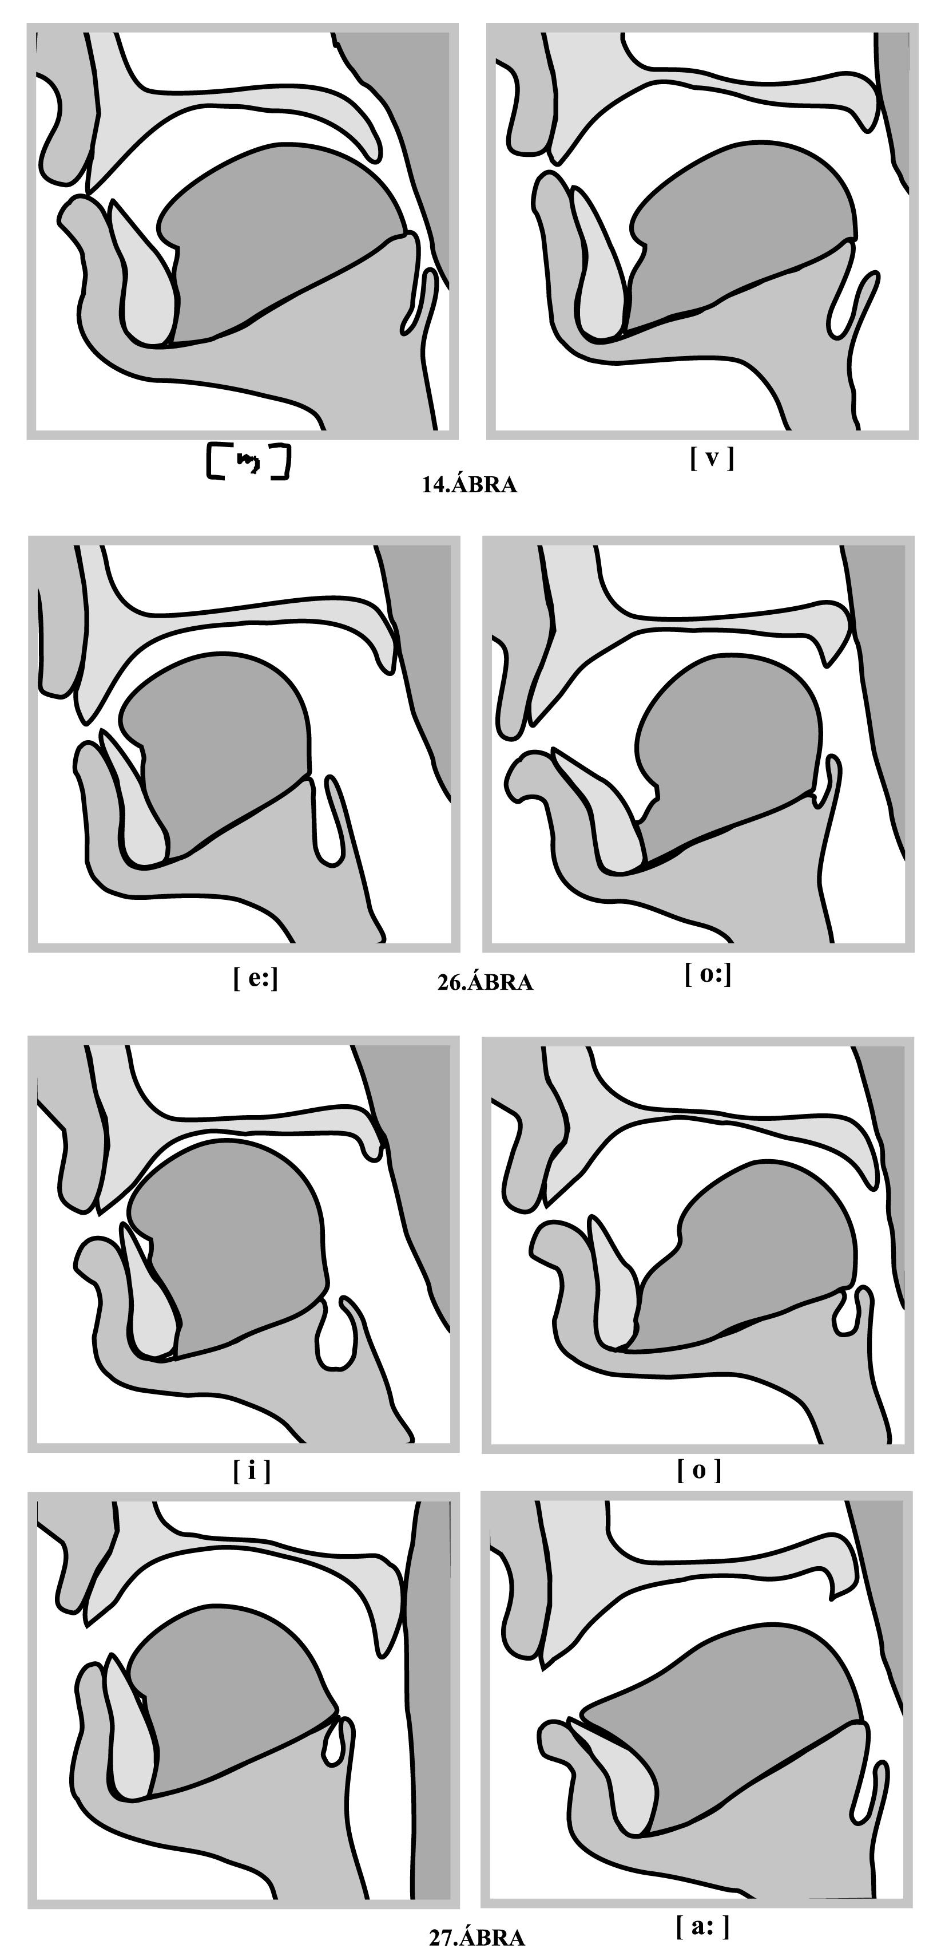
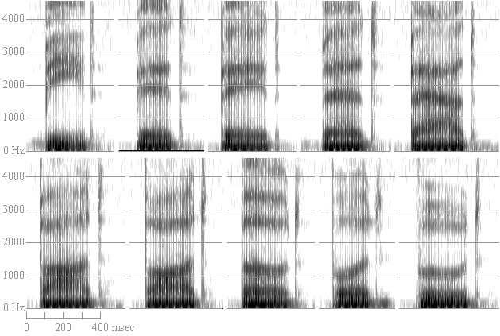
Articulation and acoustics
i
a

Slide 13
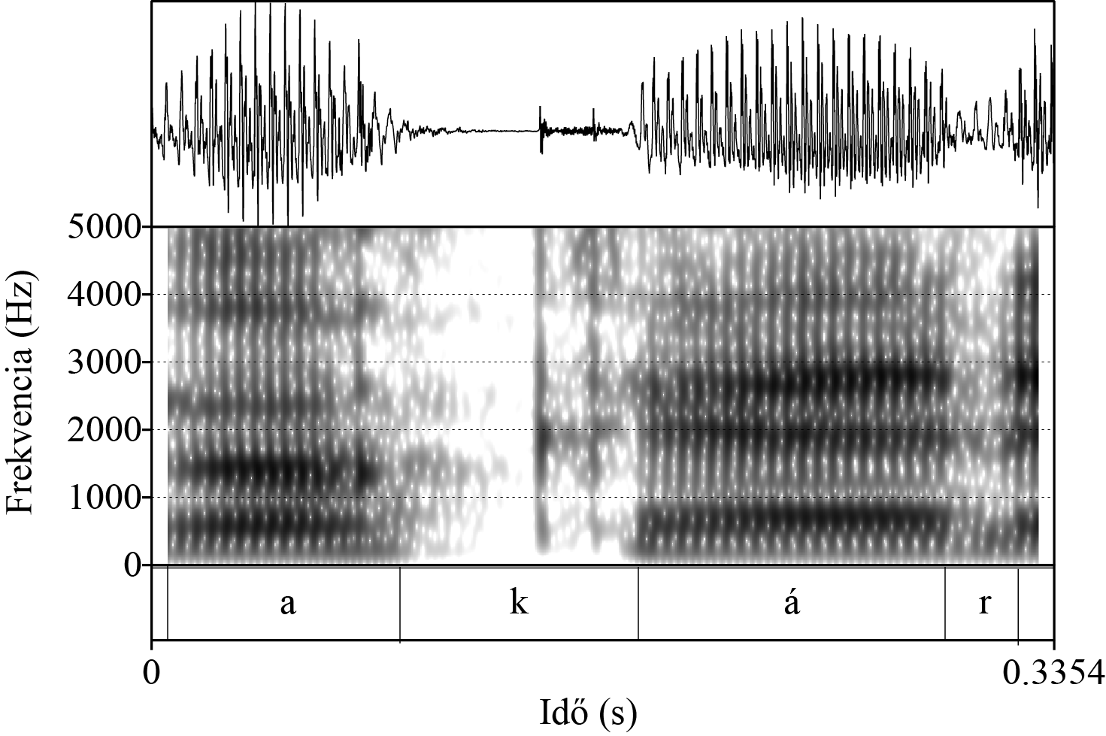


The Hungarian / /: research question
?

Slide 14
Methodology
Spontaneous speech samples were used from the (Hungarian) BEA Speech database.
Narratives of 14 females and 14 males (ages between 22 and 28).
The duration of the recorded speech samples varied across speakers (the mean duration per speaker was 26 minutes).
614 realizations in the females’ speech samples and 695 realizations in the males’ speech samples.

Slide 15
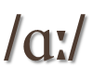

Methodology
The first three formants of the vowel were measured in the first and second syllables of the words.
The vowel quality of these vowels was defined by two phoneticians.
In addition, two more Hungarian vowels were analyzed: and .
Examples: fák, már, látogatókkal, támad, bármelyik; órákban, kutyám, inkább, találkoztunk, egymáshoz.

Slide 16
Methodology
Measurements of the formants: in the middle of the steady-state phase of the vowel (manually) considering the visual information of both the spectrograms and oscillograms (using Praat software: Boersma & Weenink 2011).
In addition, the energy spectra of the vowels were also used (FFT-analysis, Fast Fourier Transformation) to support the values of the three formants.
Statistical analysis was carried out by SPSS 17 software.

Slide 17
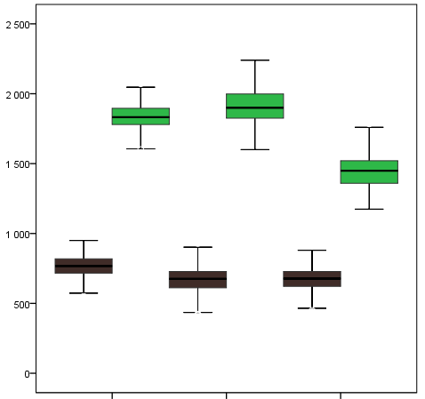
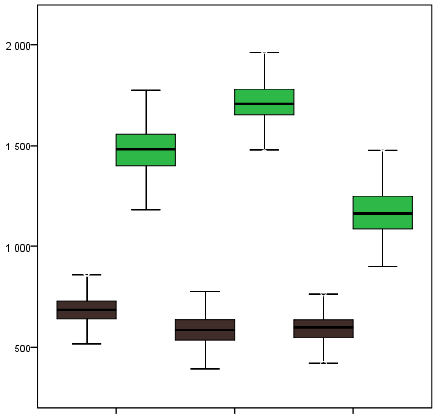
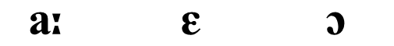
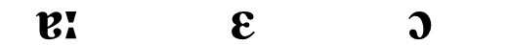
Results: F1- and F2-values
Hz
Hz
females
males

Slide 18
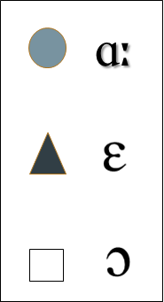
All vowels: females

Slide 19
All vowels: males

Slide 20
All Hungarian vowels
females
males

Slide 21
Changes in F2-values
Formant data from the past (Magdics 1965) provide support for the claim that in articulating this vowel the tongue occupies a back position in the oral cavity.
Formant data from the recent past (Kovács 2004, Beke & Gráczi 2010, Gráczi & Horváth 2010) provide support for the claim that in articulating this vowel the tongue occupies a more front position.

Slide 22

Summary
It has been demonstrated by measurements of formant values on a large body of spontaneous speech material that young female speakers’ second formants of clearly exhibit values characteristic of front vowels.
Given that F2 is the acoustic manifestation of the horizontal (front–back) movement of the tongue (Slifka 2005), it can be concluded that , whether or not it is phonologically attributed the feature value [+ back], is phonetically a front vowel.

Slide 23

Summary
In the case of young male speakers, the data also prove that their vowel is fronted within the oral cavity, albeit the actual tongue position is central (or front-retracted), not as clearly front as in the case of female speakers.
These data unambiguously confirm that a historical change has occurred (or, is just occurring) with respect to the articulation of this vowel, influencing the phonetic definition of the surface realization of the Hungarian vowel phoneme .

Slide 24

Discussion
The rules of Hungarian vowel harmony are rather complex anyway (cf. e.g. Hayes et al. 2009; Törkenczy 2011, Rebrus et al. 2012).
Should they be further complicated by describing the alternation between and as that between a mid front vowel and a lower low (retracted) front vowel, as the phonetic data seem to suggest?

Slide 25
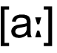
Discussion
Or else the distinctive feature values of this language should be made (or allowed to become) more abstract in that the ‘lower low front unrounded long vowel’ should simply go on to be phonologically classified as ‘low back unrounded’ ?

Slide 26
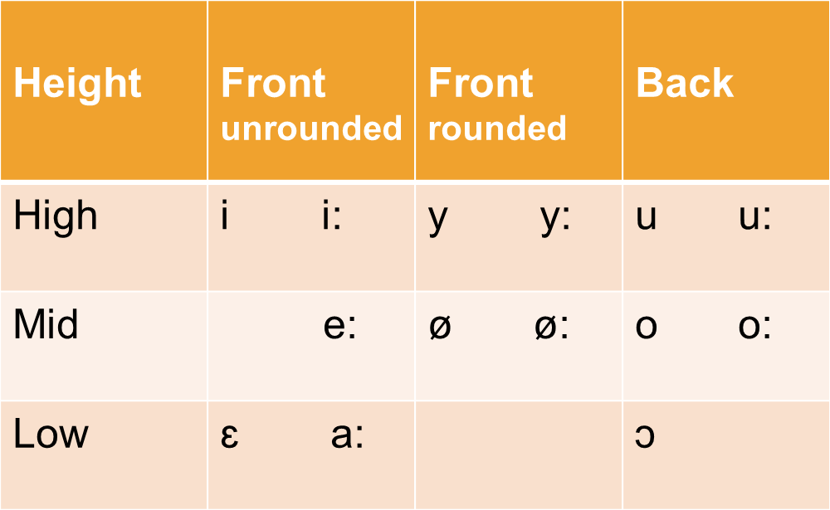

Slide 27
References
Archangeli, Diana & Douglas Pulleyblank 1994. Grounded Phonology. Cambridge MA: MIT Press.
Beke, András & Tekla Etelka Gráczi 2010. A magánhangzók semlegesedé-se a spontán beszédben [Vowel neutralization in spontaneous speech]. In: Judit Navracsics (ed.) Nyelv, beszéd, írás. Pszicholingvisztikai tanulmányok I. Veszprém: Pannon Egyetem. 57–64.
Boersma & Weenink 2011. Praat: doing phonetics by computer.
Gráczi, Tekla Etelka & Viktória Horváth 2010. A magánhangzók realizációja spontán beszédben [The realization of vowels in spontaneous Hungarian]. Beszédkutatás 2010: 5–16.
Hayes, Bruce, Kie Zuraw, Péter Siptár & Zsuzsa Londe 2009. Natural and unnatural constraints in Hungarian vowel harmony. Language 85: 821–862.
Kovács, Magdolna 2004. Pros and cos about Hungarian [a:]. Grazer Linguistische Studien 62: 65–75.

Slide 28
References
Magdics, Klára 1965. A magyar beszédhangok akusztikai szerkezete [The acoustic structure of Hungarian speech sounds]. Nyelvtudományi Értekezések 49. Budapest: Akadémiai Kiadó.
Rebrus, Péter, Péter Szigetvári & Miklós Törkenczy 2012. Dark secrets of Hungarian vowel harmony. In: Eugeniusz Cyran, Henryk Kardela & Bogdan Szymanek (eds.): Sound ,Structure and Sense. Studies in memory of Edmund Gussmann. Lublin: Wydawnictwo KUL, 491–508.
Siptár, Péter & Miklós Törkenczy 2000. The Phonology of Hungarian. Oxford & New York: Oxford University Press.
Slifka, Janet 2005. Acoustic cues to vowel–schwa sequences for high front vowels. Journal of the Acoustical Society of America 118: 2037.
Törkenczy, Miklós 2011. Hungarian vowel harmony. In: Marc van Oostendorp, Colin Ewen, Elizabeth Hume & Keren Rice (eds.): The Blackwell Companion to Phonology. Oxford: Wiley-Blackwell, 2963–2989.

Slide 29
Thank you for your attention!

