Slide 1

Variation in THE expression of reported evidential in written Estonian
Helle Metslang
Conference on the Syntax Of Uralic Languages SOUL 2017
27-28 June 2017 Budapest
Evidentiality workshop

Slide 2
Outline
Evidentiality in Estonian
A study about variation of evidentiality devices in written text varieties
Quotative mood
pidama (‘must’) construction
Evidential participle predicate
Referring semi-postpositions
Distribution of evidentiality markers in different varieties of text
Conclusions

Slide 3
Evidentiality in Estonian 1
Evidentiality system A3 ‘reported vs everything else’ in Circum-Baltic languages (Estonian, Livonian, Latvian, Lithuanian, German) (Aikhenvald 2006, Kehayov 2008)
As a functional category referring evidential has occurred in dialects, and in written texts since the 18th century (Kask 1984)
Devices of expression vary
Grammaticalized quotative and evidentiality strategies

Slide 4
Evidentiality in Estonian 2
Expression of evidentiality depends on the choice of the speaker; it is not obligatory
Function: informing about reportedness. Distancing from the source of the message, marking a rumour, politeness, irony
In a more formal text it rather refers or quotes by means of a reporting phrase or clause that shows the source of the information

Slide 5
Main devices of reported evidentiality in modern Estonian 1
Quotative mood (marker –vat)
    Ameerikas loo-vat robot muusikat
    ‘In America a robot is said to compose music’
Construction with the verb pidama ‘must’ in the past tense
    Homme pid-i tule-ma ilus ilm
    ‘It is said that tomorrow the weather will be fine’
Lone past participle as predicate
Mees läi-nud metsa, karu tul-nud vastu
‘A man is said to have gone to the forest; a bear is said to have come from the opposite direction’

Slide 6
Main devices of reported evidentiality in modern Estonian 2
Infinitive as predicate
    Selles metsas olla palju karusid
    ‘It is said that in this forest there are many bears’
Plusquamperfect
    Peeter oli metsas karu näi-nud
    ‘Peeter had seen a bear in the forest’
Outside the predicate: referring semi-postpositions sõnul, väitel, teatel etc. ‘according to’
        Vallavanema sõnul elab selles metsas üks karupere
        ‘In the words of the mayor of the rural municipality there is a bear family in this forest.’

Slide 7
The formal devices under study
Quotative
pidama-construction
Participle predicate
Adpositional phrase

Slide 8
Studied text varieties and material
Fiction (5.6 m tokens)
Newspaper (weekly Maaleht) (4.3 m tokens)
Scientific texts (PhD theses) (2.9 m tokens)
Web text (user comments) (1.9 m tokens)
Estonian Reference Corpus http://www.cl.ut.ee/korpused/segakorpus/
via Keeleveeb http://www.keeleveeb.ee/

Slide 9
Research questions
How common is evidentiality in modern written text varieties?
Which devices of evidentiality are preferred in different text varieties?
What could be the reasons for preferences?

Slide 10
About text varieties 1
Fiction:
  less restricted by norms
  deviations are allowed especially in dialogues (licentia poetica)
  one can imitate informal spoken languages or usage that is related to the subject matter or style
  narrative is common
  the source of information may remain obscure

Slide 11
About text varieties 2
Newspaper texts
  edited in accordance with the written norms and practices
  there are different text types (news articles, opinion, feature articles including narrative
  the source of the information is usually indicated
Research papers
  provide objective information or mediate information reported elsewhere
  in the case of reporting references or quotations are preferred
  the source is provided

Slide 12
About text varieties 3
Web comments
the Internet language combines features of spoken and written language
the source of the information may remain obscure

Slide 13
Quotative mood
Marker -vat
Grammaticalized from the partitive form of the present participle that extended verba sentiendi et dicendi
Its origin is southern Estonian and it became established in the Standard Estonian in the1920s (Kask 1984)
It belongs to the verb paradigm of Standard Estonian
It can be used in all verb categories (tense, polarity, voice); it has an identical form in all persons
It marks strong distancing from the source of the message
It occurs in the second half of the 20th century in written texts; it is rare in spoken language (Sepper 2006, Toomet 2000)
In newspaper texts its use is not recommended

Slide 14
Occurrence of the quotative in the corpus
Normalized frequency per 100 000 words
FICT | NEWS | THES | COMM
54.9 | 14.7 | 13.7 | 12.6

Slide 15
Occurrence of the quotative in the corpus

Slide 16
Quotative: examples 1
Events, states, recurrent actions, and positions are reported. The source of the message may be obscure.
  Olin tookord viiekümne nelja aastane ja esimest korda tekkis tungiv tarve rääkida vanatädiga, kes olevat olnud nõid. (FICT)
  ‘Then I was 54 years old and for the first time there was an urgent need to speak to the old lady who is said to have been a witch.’
  Ameerikas ja Rootsis olevat naised kombainiroolis üsnagi levinud nähtus. (NEWS)
  ‘It is said that in America and Sweden women operating combine harvesters were a rather common phenomenon.’

Slide 17
Quotative: examples 2
In a scientific text the source is usually known; the utterance in the quotative distances the reporter from the source
  Pärtelpoja sõnul võivat õpilased antud moto irooniat valesti tõlgendades hakata pidama ajaloolisi vaenlasi lõbusateks mehikesteks, mitte aga neid vihkama. (THES)
  ‘According to Pärtelpoeg, pupils who misinterpret the irony of the motto could start to regard historical enemies as funny little men and not hate them.’

Slide 18
Quotative form of the pidama-construction
    See tõbi pidavat kergesti ravile alluma. (COMM)
    ‘This disease is said to be easily subjected to treatment’
Double marking of evidentiality
More informal than the quotative of a lexical verb (alluvat)
More clearly evidential than the pidama-construction in the indicative (pidi alluma)
There were 6 occurrences in NEWS and 22 occurrences in COMM in qualitatively analysed material (100 sentences from each text variety

Slide 19
Evidential pidama-construction
The indicative past form of the modal verb pidama ‘must’ + the supine of a lexical verb
pidama is a polysemous verb (agent-centred and epistemic modality, intention, avertive, evidentiality) (Erelt 2001)
Temporal meaning mostly present, generic time, or future
It marks but does not emphasize that the information has been reported
It was rarely used in newspapers and fiction in the 20th century but is characteristic of spoken language (Sepper 2006, Toomet 2000)

Slide 20
Evidential pidama-construction in the corpus
Normalized frequency per 100 000 tokens
FICT | NEWS | THES | COMM
3.3 | 2.9 | 0.5 | 6.1

Slide 21
Occurrence of the evidential pidama-construction in the corpus

Slide 22
pidama-construction: examples
It is widespread especially in web comments; reporting of generalized views, the source is obscure
  Viinamürgitusega pidi enne surma palav hakkama (NEWS)
  ‘It is said that in the case of alcohol poisoning one feels hot before dying.’
  Kaitsmine pidi ju mõttetu olema. (COMM)
  ‘It is said that defence is senseless.’
  Rootsis pidid naised nii kövasti sünnitama et sünnitusmajades polevat vabu kohtigi. (COMM)
  ‘It is reported that in Sweden there are so many women giving birth to children that there are no places in maternity hospitals.’

Slide 23
Past participle as evidential predicate
Marker -nud (personal), -tud (impersonal)
Temporal meaning of the definite past; only affirmative, personal; identical form in all the persons
Typical use in narratives, when reporting a string of events
Indicates archaic, folksy style
It was common in newspaper texts in the1890s
It is rare in the fiction and newspaper corpora of the 20th century (Sepper 2006)
It is widespread in spoken language (Toomet 2000)

Slide 24
Occurrence of the evidential participle predicate in the corpus
Normalized frequency per 100 000 tokens
FICT | NEWS | THES | COMM
103.5 | 27.8 | 0 | 0.6

Slide 25
Occurrence of the evidential participle predicate in the corpus

Slide 26
Evidential participle predicate: examples
Ema võtnud kapist pitsid välja ja nad rüübanud ühepajatoidu kõrvale viskit (FICT)
‘Mother is said to have taken glasses from the cupboard and they are said to have sipped whisky with the one-pot dish.’
Seal valitsenud halvad tööohutuse tingimused, mille tulemusena ta sattunud kättpidi mehhanismide vahele ja kaotas käelaba (NEWS)
‘It is reported that occupation safety had been poor there and as a consequence his hand happened to be caught by some machinery and he lost it.’

Slide 27
Referring semi-postpositions
The adessive forms of the nouns sõna ‘word’, teade ‘message’, väide ‘claim’, hinnang ‘assessment’ are developing into referring adpositions (‘according to…’)
The compact form of the reporting phrase (by comparison with the reporting clause) is characteristic of written language
Show the source of the message
Recommended in newspaper texts of the past decades
Use in newspaper texts shows an abrupt increase in the 1990s
Rare in fiction (Sepper 2006)
No data about their use in spoken language

Slide 28
Referring postpositional constructions with sõnul, väitel in the corpus
Normalized frequency per 100 000 tokens
FICT | NEWS | THES | COMM
0.2 | 8.2 | 0.5 | 1.3

Slide 29
Referring postpositional constructions with sõnul, väitel in the corpus

Slide 30
Referring postpositional constructions: examples 1
Especially characteristic of newspaper texts: the information sources usually represent official positions and social groups
sõnul (<word.pl:ade) is more neutral and expresses only reporting
väitel (<claim:ade) provides also a clue to the position of the information source
  Ministri sõnul praegu vabakaubanduslepinguid enam muuta ei saa. (NEWS)
  ‘In the words of the minister it is now impossible to change the free trade treaties’
  Võrdõiguslikkuse seadus pole ministri väitel mingi "naisteseadus“ (NEWS)
  ‘According to the minister, the equality act is by no means a ‘female act’’

Slide 31
Referring postpositional constructions: examples: 2
Comments reveal diverse sources of information
    Aga mina räägin eesti keelt mu sõbranna sõnul soome aktsendiga. (COMM)
    ‘But I speak in my friend’s words Estonian with the Finnish accent’
Väitel is more common on scientific texts; sõnul is more widespread in other text varietis
    Modernistide väitel on rahvused tekkinud alles paari viimase sajandi vältel. (THES)
    ‘Modernists claim that nationalities have emerged only during the past few centuries.’

Slide 32
Occurrence of the four evidential markers in the corpus in total
Normalized frequency per 100 000 tokens
FICT | NEWS | THES | COMM
161.9 | 53.6 | 14.7 | 20.6

Slide 33
Occurrence of evidential markers in the corpus in total

Slide 34
Distribution of evidential markers in fiction

Slide 35
Distribution of evidential markers in newspaper texts

Slide 36
Distribution of evidential markers in scientific texts

Slide 37
Distribution of evidential markers in web comments

Slide 38
Distribution of evidential markers in text varieties

Slide 39
Conclusions: the markers
Estonian has various markers for the expression of reported evidentiality; their functions and use are somewhat different.
Despite the fact that the quotative has been regarded as rare and highly written, its use is revealed in all the studied text varieties, including web comments.
Although the participle predicate has been considered to be archaic, it is still used in fiction and also in newspaper texts.
The pidama-construction that has been thought to be characteristic of spoken language is widespread especially in web comments.
Referring adpositional phrases that are characteristic of newspaper texts occur to some extent also in web comments.

Slide 40
Conclusions: evidentiality in text varieties
Evidential markers are most widespread in fiction.
The participle predicate rendering the narrative predominates in fiction; the quotative is rather common, too.
According to the frequency of occurrence, newspaper texts come next. Different devices, including referring adpositional phrases, are less used. The large proportion of the participle predicate could be explained by the specific nature of the material of the weekly.
Scientific texts reveal little evidentiality; the quotative is predominant, the participle predicate is not used.

Slide 41
Conclusions: evidentiality in the new media
Web comments reveal the hybrid nature of Internet language. The quotative is characteristic of written language; at the same time the pidama-construction that is characteristic of spoken language is also common, as well as a combination of these two devices.
A new increase in the use of the vat-form, which has been regarded as generally marginal, speaks of the stability of the functional category of evidentiality and the viability of a simple and clear marker in informal written communication.

Slide 42
References
Aikhenvald, Alexandra 2006. Evidentiality. Oxford University Press.
Erelt, Mati. 2001. “Some notes on the grammaticalization of the verb pidama in Estonian”, Estonian Typological Studies V, Publication of the department of Estonian of the University of Tartu 18. Tartu: Tartu University Press. 6-25.
Kask, Arnold 1984. Eesti murded ja kirjakeel. Tallinn.
Kehayov, Petar 2008. An areal-typological perspective to evidentiality: the cases of the Balkan and Baltic linguistic areas. Tartu.
Sepper, Maria-Maren 2006. Indirektaal eesti 19. sajandi lõpu ja 20. sajandi aja- ja ilukirjanduskeeles, Tallinna Ülikool.
Tamm, Anne 2012. Partitive objects and the partitive evidential marker -vat in Estonian express incomplete evidence. Finnisch-ugrische Mitteilungen, 35, 97−140.
Toomet, Piret 2000. Mõnest kaudsuse väljendamise võimalusest tänapäeva eesti keeles. ­– Keel ja Kirjandus 4: 251–259.

Slide 43
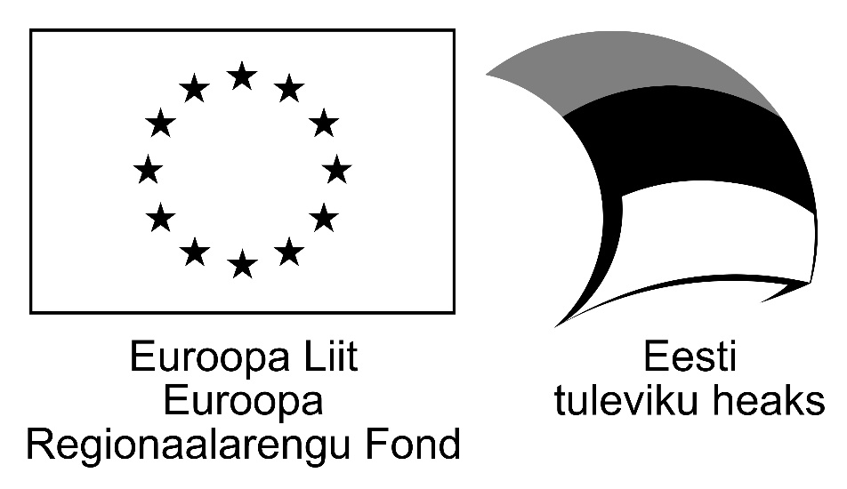

Aitäh!
Contact-induced change in Finno-Ugric languages
SCIENTIFIC COOPERATION BETWEEN THE ESTONIAN ACADEMY OF SCIENCES ANDTHE HUNGARIAN ACADEMY OF SCIENCES

