Slide 1
Nominalizations in Hill Mari
Anastasiia Voznesenskaia, MSU
Conference on the Syntax Of Uralic Languages 2017, 27 June

Slide 2
Referential Nominals vs. Argument-Structure Nominals
(1) a. the instructor’s (intentional) examination of the student
b. the frequent collection of mushrooms (by students)
c. the monitoring of the wild flowers to document their disappearance
d. the destruction of Rome in a day
(2) a. the instructor’s examination/exam
b. John’s collections
c. these frequent destructions

Slide 3
Referential Nominals vs. Argument-Structure Nominals
Grimshaw’s diagnostics (Grimshaw 1990):
(3) AS-Nominals: θ-assignors, Obligatory arguments Event reading Agent-oriented modifiers Subjects are arguments by phrases are arguments Implicit argument control Aspectual modifiers frequent, constant etc. possible without plural Mass nouns | R-Nominals: Non-θ-assignors, No obligatory arguments No event reading No agent-oriented modifiers Subjects are possessives by phrases are non-arguments No implicit argument control No aspectual modifiers frequent, constant etc. possible only with plural nouns Count nouns

Slide 4
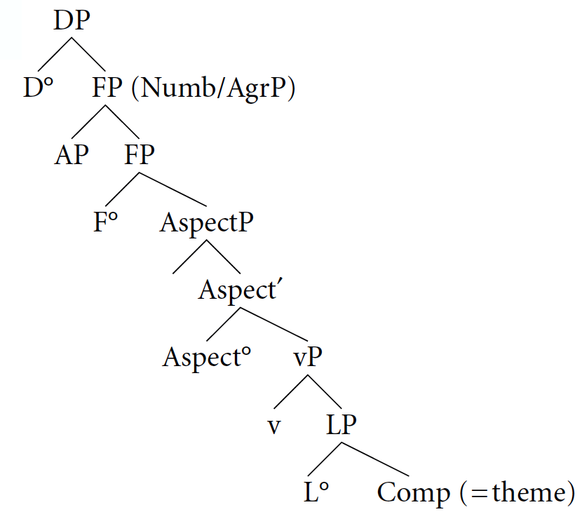
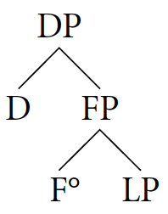
RNs vs. ASNs: a syntactic approach
(4) a. ASNs
b. RNs
Alexiadou (2001)

Slide 5
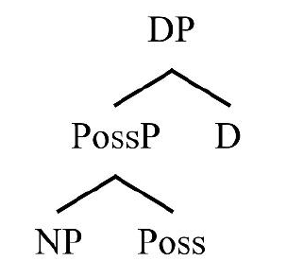
Hill Mari: Basic information
NP/DP
(5) vas’a-n täng-žə̈
Vasya-gen friend-poss.3sg
Vasya’s friend
sentential complements: nominalizations (also converbs and infinitives)
nominalizers: -mə̑- and -maš-
(6) ə̈də̈r-žə̈-n jažo(-n) kušt-ə̑maš-ə̑žə̑-m/
daughter-poss.3sg-gen good-gen dance-nmn.act-poss.3sg-acc
jažo-n kušt-ə̑mə̑-žə̑-m ävä päl-ä
good-gen dance-nmz-poss.3sg-acc mother know-npst.3[sg]
Mother knows that her daughter dances well.

Slide 6
-mə̑- nominals structure: little v
adverbial modification: manner adverbs
(7) mə̈läm täng-em-ə̈n kužə̑-n/*kužə̑
me.dat.poss.1sg friend.poss.1sg-gen long-gen /*long
xovorajə̑-mə̑-žə̑ a-k kelšə̈
be.ill-nmz-poss.3sg neg.npst-3sg please.cn
I don’t like that my friend being ill for a long time.
assignment of accusative case
(8) noski-m pid-mə̈-zə̈ papa-n
socks-acc knit-nmz-poss.3sg grandmother-gen
sə̈nzä-žə̈-m port’-ə̈n
eyes-poss.3sg-acc damage-prf.3[sg]
Knitting of socks has damaged the grandmothers eyesight.

Slide 7
-mə̑- nominals structure: Spec,vP-to-Spec,DP
wide scope of the adverb modifying the nominalization over it’s subject
(9) avi-m susuemd-ä [_{DP} kə̑də̑ tidə̈ xə̑na-vlä-n
mom-acc make.happy-npst.3[sg] some guest-pl-gen
[kə̑namžə̑ tort-ə̑m kand-ə̑mə̑-štə̑]]
sometimes cake-acc bring-nmz-poss.3pl
а. Mom is pleased by the fact that some guests are such that they sometimes bring a cake. subj > kə̑namžə̑
б. Mom is pleased by the fact that sometimes some guests (not necessarily the same ones each time) bring a cake. kə̑namžə̑ >subj

Slide 8
-mə̑- nominals structure: Negation
-də̑- is used for negation in nominalizations
(10) tə̑mdə̑šə̑ päl-ä tə̑men’šə̈-žə̈-n
teacher know-npst.3[sg] student-poss.3sg-gen
xovorajə̑-də̑-mə̑-žə̑ gišän
be.ill-neg-nmz-poss.3sg about
The teacher knows that the student is not ill.
-də̑- is attached before the nominalizer:
according to The Mirror Principle (Baker 1985) that means it’s lower in syntactic structure

Slide 9
-mə̑- nominals structure: Tense
subject of the nominalized clause may be nominative
(11) a.pet’a paša-n joškarola-štə̑
Petya Pasha-gen YoshkarOla-in
ə̑l’-ə̑mə̑-žə̑-m päl-ä
be-nmz-poss.3sg-acc know-npst.3[sg]
b. pet’a paša joškarola-štə̑ ə̑l’-ə̑mə̑-m
Petya Pasha YoshkarOla-in be-nmz-acc
päl-ä
know-npst.3[sg]
Petya knows that Pasha lives in Yoshkar-Ola.

Slide 10
-mə̑- nominals structure: Tense
adverb modification: T level adverbs according to The Universal Hierarchy (Cinque 1999)
(12) pi-n sola-štə̑ uže və̑č-ə̑mə̑-žə̑-m
dog-gen village-in already wait-nmz-poss.3sg-acc
zina mond-en
Zina forget-prf[3sg]
Zina forgot that the dog is already waiting outside.
(13) pervi puergə̈-vlä-n plat’ə̑ don kašt-m-ə̑m
once man-pl-gen dress with walk-nmz-acc
učitel' šajə̑št-ə̑
teacher tell-aor[3sg]
The teacher told (the class) that once men wore dresses.

Slide 11
-mə̑- nominals structure: Tense
Raising-to-subject: čučeš ‘seem’
case, agreement
(14) mə̈n’(*-ə̈n) [mə̈n’ xovoraj-en kolt-ə̑mə̑-la] čuč-a-m
me(*-gen) be.ill-cvb send-nmz-cmpr seem-npst-1sg
I seem to be ill.
binding: Principles A and B
(15) van’a_{i} škə̈-län-žə̈_{i}/tə̈də̈-län_{*i} [cerlän-ə̈mə̈-lä]
Vanya refl-dat-poss.3sg/he-dat become.ill-nmz-cmpr
čuč-eš
казаться-npst.3[sg]
Vanya_{i} seems to himself_{i} to have fallen ill.

Slide 12
-mə̑- nominals structure: Tense
binding: Principle C
(16) tə̈də̈_{i} [vas'a_{*i} gišän statja-m už-mə̑-la]
he Vasya about article-acc see-nmz-cmpr
čuč-eš
seem-npst.3[sg]
He_{i} seems to have seen an article about Vasya_{*i}.
scope
(17) kə̑də̑ tidə̈ tetä-vlä učite-lan [kə̑namžə̑
some kid-pl teacher-dat sometimes
sir-en näl-mə̈-lä] čuč-ə̑-t
write-cvb take-nmz-cmpr seem-npst-3pl
Some children seem to sometimes copy off.
(kə̑namžə̑ > subj, subj > kə̑namžə̑)

Slide 13
-mə̑- nominals structure: Tense
Raising-to-Subject: čučeš in the nominalized clause
agreement
(18) [mə̈n’(-ə̈n) [cerlän-ə̈mə̈-lä] čuč-m-em]
me-gen become.ill-nmz-cmpr seem-nmz-poss.1sg
ävi-m šə̑tə̑rlanə̑kt-a
mom-poss.1sg disturb-npst.3[sg]
My seeming to have fallen ill worries my mom.
binding: Principle A
(19) [van’a-n_{i} škə̈-län-žə̈_{i} [xovoraj-en kolt-ə̑mə̑-la]
Vanya-gen refl.obl-dat-poss.3sg be.ill-cvb send-nmz-cmpr
čuč-mə̑-žə̑ gišän] ävä-žə̈ pop-ə̑š
seem-nmz-poss.3sg about mom-poss.3sg say-aor[3sg]
Mom says that Vanya_{i} seems to himself_{i} to have fallen ill.

Slide 14
-mə̑- nominals structure: Tense
binding: Principle C
(19) [(tə̈də̈-n_{i}) [tə̈də̈ ške_{i} gišän-žə̈/ *maša_{i} gišän
he-gen refl about-poss.3sg Masha about
statja-m už-mə̑-la] čuč-mə̑-žə̑-m] tə̈də̈_{i}
article-acc see-nmz-cmpr seem-nmz-poss.3sg-acc he
pop-ə̑š
say-aor[3sg]
She says that she_{i} seems to have seen an article about herself_{i}/ about Masha_{*i}.

Slide 15
-mə̑- nominals structure: Tense
scope
(20) učitel'-ə̈m [kə̑də̑ tidə̈ tetä-vlä-n [kə̑namžə̑ sir-en
teacher-acc some kid-pl-gen sometimes write-cvb
näl-mə̈-lä] čuč-mə̑-štə̑] šə̈deštär-ä
take-nmz-cmpr seem-nmz-poss.3pl annoy-npst.3[sg]
Some children seeming to sometimes copy off annoys the teacher.
(kə̑namžə̑ > subj, subj > kə̑namžə̑)

Slide 16
-mə̑- nominals structure: plural
nominals derived from telic stems can pluralize
(21) val’a-n tokə̑žə̑ pozdan ^{ОК}tol-mə̑-vlä-žə̑
Valya-gen home late ^{ОК}come-nmz-pl-poss.3sg
ävä-žə̈-m šə̈deštär-ä-t
mom-poss.3sg-acc annoy-npst.3-pl
Valya’s comings home late annoy her mother.
nominals derived from atelic stems cannot
(22) paškudə̑ pi-n so mə̈n’-ə̈m
neighbour dog-gen always me-acc
optə̑-mə̑-(*vlä)-žə̑ mə̈n’-ə̈m šə̈deštär-ä
bark-nmz-pl-poss.3sg me-acc annoy-npst.3[sg]
The neighbourhood dog always barking at me annoys me.

Slide 17
-mə̑- nominals structure: PossP and DP
PossP
(23) mə̈n' və̑č-e-m jur tol-m-ə̑m/
me wait-npst-1sg rain go-nmz-acc
jur-ə̑n tol-mə̑-žə̑-m
rain-gen go-nmz-poss.3sg-acc
I’m waiting for it to rain.
DP
the universality of DP (for hill mari argued for in Pleshak (2017))

Slide 18
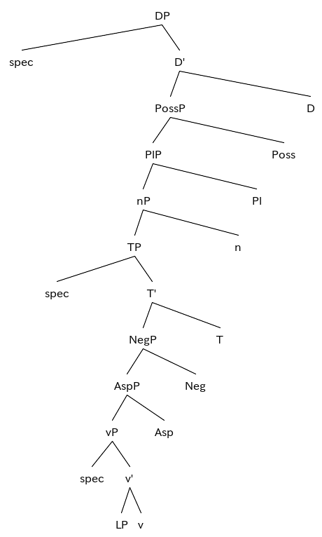
-mə̑- nominals: resulting structure
maximal structure of -mə̑- nominalizations

Slide 19
-maš- nominals: the division
cannot be derived from atelic stems
(24) mə̈n' alina-n mägə̈r-ə̈mə̈-žə̈-m/
me Alina-gen cry-nmz-poss.3sg-acc/
*mägə̈r-ə̈mäš-ə̈žə̈-m kol-ə̑n-am
cry-nmn.act-poss.3sg-acc hear-prf-1sg
I heard Alina cry.
native speakers fall into two groups:
R-nominal: [_{DP} [_{PossP} [_{PlP} [_{nP} -maš- [_{LP} ]]]]]
AS-nominal: at least [_{DP} [_{PossP} [_{PlP} [_{nP} -maš- [_{vP} [_{LP} ]]]]]]

Slide 20
-maš- nominals as ASNs: little v
adverbial modification
(25) stroitel-vlä-n toma-m jori
builder-pl-gen house-acc intentionally
pə̑də̑rtə̑-maš-ə̑štə paškudə̑-vlä-m šə̈deštär-ä
break-nmn.act-poss.3pl neighbor-pl-acc annoy-npst.3[sg]
The intentional destruction of the house by the constructors annoys the neighbors.
(26) stroitel-vlä-n kok cäš utla toma-m
builder-pl-gen two hour more house-acc
pə̑də̑rtə̑-maš-ə̑štə̑ paškudə̑-vlä-m šə̈deštär-ä
break-nmn.act-poss.3sg neighbor-pl-acc annoy-npst.3[sg]
The destruction of the house for more than two hours annoys the neighbours.

Slide 21
-maš- nominals as ASNs: little v
assignment of accusative case
(27) plof-ə̑m ə̈štə̈-mäš mə̈läm
pilaw-acc make-nmn.act me.dat.poss.1sg
kelš-ä
please-npst.3[sg]
I like cooking pilaw.

Slide 22
-maš- nominals as ASNs: little v
derivational markers retained
(28) a. ə̈rvezäš-ə̈n kaxə̑r-maš-ə̑žə̑ cilä kol-ə̑m
boy-gen cough-nmn.act-poss.3sg all fish-acc
lüdə̈kt-en
scare-prf[3sg]
The boy’s coughing scared away all the fish.
b. ə̈rvežäs-ə̈n (ik gänä) kaxə̑r-alt-maš-ə̑žə̑ cilä
boy-gen once cough-att-nmn.act-poss.3sg all
kol-ə̑m lüdə̈kt-ə̈š
fish-acc scare-aor[3sg]
The boy’s coughing (once) scared away all the fish.

Slide 23
-maš- nominals as ASNs: Negation
the same marker -də̑-
(30) tə̑mdə̑šə̑ paša-n urok-ə̑m
teacher Pasha-gen homework-acc
ə̈štə̈-də̈-mäš-ə̈žə̈-m päl-ä
do-neg-nmn.act-poss.3sg-acc know-npst.3[sg]
The teacher knows that Pasha didn’t do the homework.
also attached before the nominalizer

Slide 24
-maš- nominals as ASNs: resulting structure
lack of data on -maš- nominals
-maš- nominals structure:
RNs: [_{DP} [_{PossP} [_{PlP} [_{nP} -maš- [_{LP} ]]]]]
ASNs:
minimal structure: [_{DP} [_{PossP} [_{PlP} [_{nP} -maš- [_{vP} [_{LP} ]]]]]]
maximal structure: [_{DP} [_{PossP} [_{PlP} [_{nP} -maš- [_{NegP} [_{AspP} [_{vP} [_{LP} ]]]]]]]]
Why no TP?:
no nominative of subject
no T-level adverbs

Slide 25
Thank you for your attention!

